Slide 1
Design of 4-bit Hybrid Arithmetic Logic Unit in 65nm Technology
UNDER THE GUIDANCE OF
Mr. A. Ashok Kumar, M.Tech ,(Ph.D)
Assistant Professor
Presented by
ASHISH KUMAR (20331A0414)
D. V. V. SAI RAM(20331A0454)
CH.DIVYA SHANTHI(21335A0402)
B.GOPICHAND(20331A0435)

Slide 2
CONTENTS
Abstract
Introduction of 4-bit ALU
a)Design of 1-bit ALU
1. Arithmetic Unit
2. Logical Unit
Literature Survey
Design of 4-bit ALU using CMOS, PTL, TG
Comparison of 4-bit ALU in various technologies
Proposed Low Power 4-bit Hybrid ALU
Proposed High Performance 4-bit Hybrid ALU
Conclusion
Future Scope
References

Slide 3
Abstract
ALU is a main component of the central processing unit, which stands for arithmetic logic unit and performs arithmetic and logic operations. It has the ability to perform all processes related to arithmetic and logic operations such as addition, subtraction, and shifting operations, including Boolean comparisons (XOR, OR, AND, and NOT operations).
The main aim is to design an efficient ALU comparing the building modules of ALU with different techniques like CMOS,PTL and GDI and bring out the best performing Arithmetic Logic Unit.
Simulation is to be done using cadence virtuoso tool in 65nm technology

Slide 4
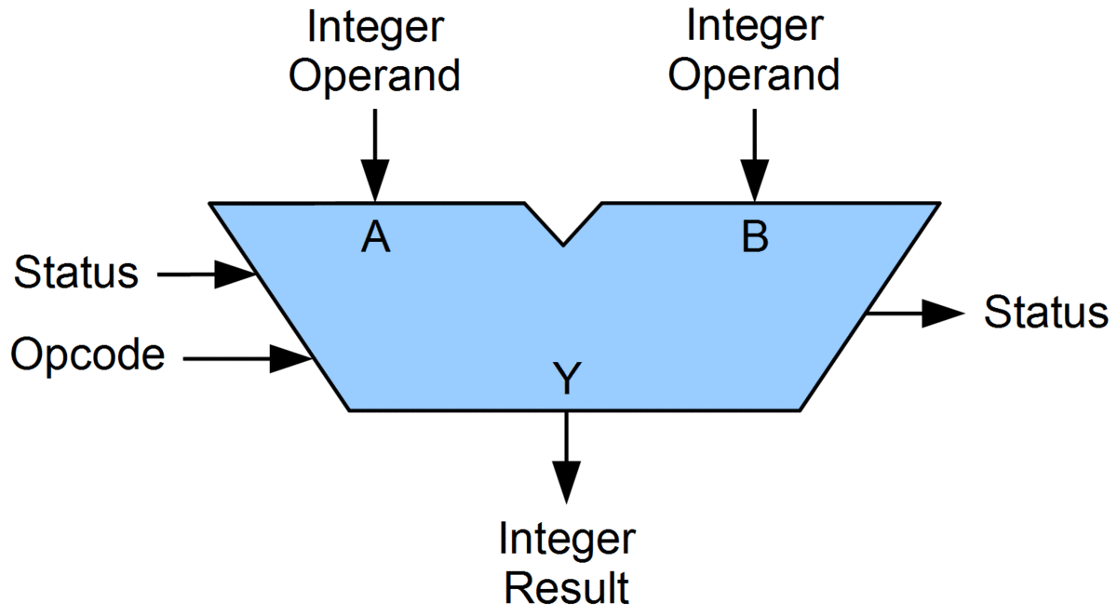
Arithmetic and Logic Unit (ALU)
In the computer system, ALU is a main component of the central processing unit, which stands for arithmetic logic unit and performs arithmetic and logic operations.
It has the ability to perform all processes related to arithmetic and logic operations such as addition, subtraction, and shifting operations, including Boolean comparisons (XOR, OR, AND, and NOT operations).
The arithmetic logic unit is split into AU (arithmetic unit) and LU (logic unit). The operands and code used by the ALU tell it which operations have to perform according to input data. When the ALU completes the processing of input, the information is sent to the computer's memory.

Slide 5
Four bit ALU
A 4-bit ALU, built from 1-bit ALU modules, performs arithmetic and logical operations on 4-bit binary numbers. Each 1-bit module handles addition, subtraction, transfer, increment, decrement, AND, OR, XOR, and NOT operations, enabling versatile computing in digital systems.
S3 | S2 | S1 | S0 | Cin | OUT
0 | 0 | 0 | 0 | 0 | A+B
0 | 0 | 0 | 0 | 1 | A+B+1
0 | 0 | 0 | 1 | 0 | A+B’
0 | 0 | 0 | 1 | 1 | A+B’+1
0 | 0 | 1 | 0 | 0 | A
0 | 0 | 1 | 0 | 1 | A+1
0 | 0 | 1 | 1 | 0 | A-1
0 | 0 | 1 | 1 | 1 | A
0 | 1 | 0 | 0 | X | A and B
0 | 1 | 0 | 1 | X | A or B
0 | 1 | 1 | 0 | X | A xor B
0 | 1 | 1 | 1 | X | A’
1 | 0 | X | X | X | shr A
1 | 1 | X | X | X | shl A

Slide 6
One bit ALU
A 1-bit ALU, composed of arithmetic and logical units, executes addition, subtraction, transfer, increment, decrement operations, and performs AND, OR, XOR, NOT logical operations, enabling versatile computing functions at the bit level.
S3 | S2 | S1 | S0 | Cin | OUT
0 | 0 | 0 | 0 | 0 | A+B
0 | 0 | 0 | 0 | 1 | A+B+1
0 | 0 | 0 | 1 | 0 | A+B’
0 | 0 | 0 | 1 | 1 | A+B’+1
0 | 0 | 1 | 0 | 0 | A
0 | 0 | 1 | 0 | 1 | A+1
0 | 0 | 1 | 1 | 0 | A-1
0 | 0 | 1 | 1 | 1 | A
0 | 1 | 0 | 0 | X | A and B
0 | 1 | 0 | 1 | X | A or B
0 | 1 | 1 | 0 | X | A xor B
0 | 1 | 1 | 1 | X | A’
1 | 0 | X | X | X | 0
1 | 1 | X | X | X | 0

Slide 7
Arithmetic Unit
S1 | S0 | Cin | OUT | FUNCTION
0 | 0 | 0 | A+B | ADD
0 | 0 | 1 | A+B+1 | ADD WITH CARRY
0 | 1 | 0 | A+B’ | SUBTRACT WITH BORROW
0 | 1 | 1 | A+B’+1 | SUBTRACT
1 | 0 | 0 | A | TRANSFER A
1 | 0 | 1 | A+1 | INCREMENT A
1 | 1 | 0 | A-1 | DECREMENT A
1 | 1 | 1 | A | TRANSFER A
The arithmetic unit facilitates essential mathematical operations on binary numbers. It performs addition, addition with carry, subtraction with borrow, standard subtraction, transfers the value of A, increments and decrements A, and transfers A to another location. These functionalities enable efficient arithmetic computations in digital systems.

Slide 8
Logical Unit
The logical unit in digital systems executes essential AND, OR, XOR, and NOT operations. The AND gate outputs true only if both inputs are true (Q = A * B), the OR gate outputs true if at least one input is true (Q = A + B), the XOR gate outputs true if exactly one input is true (Q = A ⊕ B), and the NOT gate outputs the inverse of its input (Q = !A). These operations are fundamental in computing applications.
S1 | S0 | OUT | FUNCTION
0 | 0 | AB | AND
0 | 1 | A+B | OR
1 | 0 | A⨁B | XOR
1 | 1 | A’ | NOT

Slide 9
Literature Survey
Review of papers based on ALU designed with CMOS technique
Optimization of area is important in today’s VLSI technology ,where static c-mos does not provide all those facilities. So the logic gates are designed using advanced techniques and the ALU with optimized area is designed
4 bit ALU is designed using a full adder with 6 transistors and other logic gates instead of using conventional c-mos full adder with 28 transistors .Transient response and power analysis is done ,where the new proposed design is performing well in terms of power and area
45nm technology based 8 bit ALU is proposed where 2:4 decoder ,4:1 mux is used and the power consumption is compared with general ,adiabatic ,VHDL, multilevel approaches based ALU and less power consumotion is obtained

Slide 10
contd
8 bit ALU is designed where the gate count is optimized by 25 gates using an advanced technique in full adder design .The area is also reduced and power requirement for the circuit is 0.064mW
16 bit ALU is designed where adder is designed using the STATIC CMOS logic, which usually requires an additional number of transistors. However, in the case of the proposed solution, the requirement for additional transistors too was mitigated Advancement in time delay and percentage delay is mitigated by 30 percent.

Slide 11
Review of paper based on ALU designed with PTL technique
A low power ,area pass transistor logic based ALU is designed where the leakage is reduced therefore reducing the power consumption. Transient response ,delay analysis, power analysis is done. It is compared with previous work done where it is found 98% efficient than the previous one.
A PTL based power efficient 4 bit ALU using 45nm technology is designed where an efficient 4 but adder is designed cascading half adder and full adder and it is compared with the previous work done using 65nm technology and nullified leakage power is obtained

Slide 12
contd
A low power ALU is designed where 8T FA and PTL based MUX circuits are used with less no of transistors. The power and area are optimized by 70% compared to the existing method.
Average power consumed in 64 bit ALU using CMOS logic is 10.01mW and by using PTL logic power consumption has been reduced to 5.50mW. It is observed that the number of transistors in PTL method is less than CMOS method. So area reduced and then power also reduced. As shown in tabular diagram the average power consumption in PTL method is around 55% less than CMOS method.

Slide 13
Review on papers based on ALU designed with GDI technique
4 bit ALU using GDI technique is designed where delay time is optimized. Average power, peak power, no of transistors used are compared with general ALU
Low power and area efficient ALU is designed using GDI technique where all the individual modules are designed using GDI technique and it is compared with conventional CMOS
In GDI we have 3 types
a)GDI :-used for reducing power in many circuits
b)m-GDI :- terminals are maintained in one potential
c)FS-GDI :- it uses less transistors than cmos and produces full swing output
45 nm technology based 16 bit efficient alu is designed using full swing GDI

Slide 14
contd
ALU using low power GDI standard cells is designed where xor gate is designed using 4 gates with GDI logic where in CMOS 6 transistors is required. 4 bit ALU and 8 bit ALU using GDI technique is compared with cmos on the basis of dynamic, leakage, total power

Slide 15
S.NO | TITLE | DATE OF ISSUE | AUTHORS | TECHNIQUE USED
1 | A 8 Bit ALU Design using Cadence | Aug 2020 | Yuvashree G S | CMOS
2 | LOW POWER-AREA DESIGN OF FOUR BIT ALU | 2 April 2021 | Gaurav Sharma | CMOS
3 | 45nm Technology Based 8-bit ALU Design | March 2019 | G. Sireesha | CMOS
4 | Low Power-Area Pass Transistor Logic Based ALU Design Using Low Power Full Adder Design | 2019 | G.Karthik Reddy | PTL
5 | A PTL based power efficient ALU block using 45nm Technology | 25 May 2021 | Venkat Bhavani Nayak Vadithe | PTL

Slide 16
S.NO | TITLE | DATE OF ISSUE | AUTHOR | TECHNIQUE USED
6 | Performance evaluation of an efficient ALU | 2018 | Multiple authors | GDI
7 | Design and Implementation of ALU using GDI Technique | Dec,2019 | D.Vigneshwari | GDI
8 | Design of 16-bit ALU Using Full-Swing GDI Technique | 2022 | Poorvaja Harish | GDI
9 | Design of a 4 bit Arithmetic and Logical unit with Low Power and High Speed | March 2021 | C.Arunabala | PTL

Slide 17
S.NO | TITLE | DATE OF ISSUE | AUTHORS | TECHNIQUE USED
10 | 8 bit ALU with advanced full gate design | 2020 | MULTIPLE | CMOS
11 | Optimized 16 bit ALU design for better performance | 2019 | Gaurav | CMOS
12 | Low power ALU using PTL logic | 2021 | MULTIPLE | PTL
13 | Design of 64 bit ALU with less power consumption | 2022 | Dr.Suyash | PTL
14 | GDI based ALU with less leakage power | 2021 | Ramakanth,suyash | GDI

Slide 18
Design of 4-bit ALU using CMOS, PTL, TG
AND
An AND gate is a digital logic gate that produces an output (often denoted as Q) only when both of its inputs (denoted as A and B) are true or high. In other words, the output is true if and only if both inputs are true. The AND gate's behavior can be expressed as follows: Q=A⋅B
A | B | O/P
0 | 0 | 0
0 | 1 | 0
1 | 0 | 0
1 | 1 | 1

Slide 19
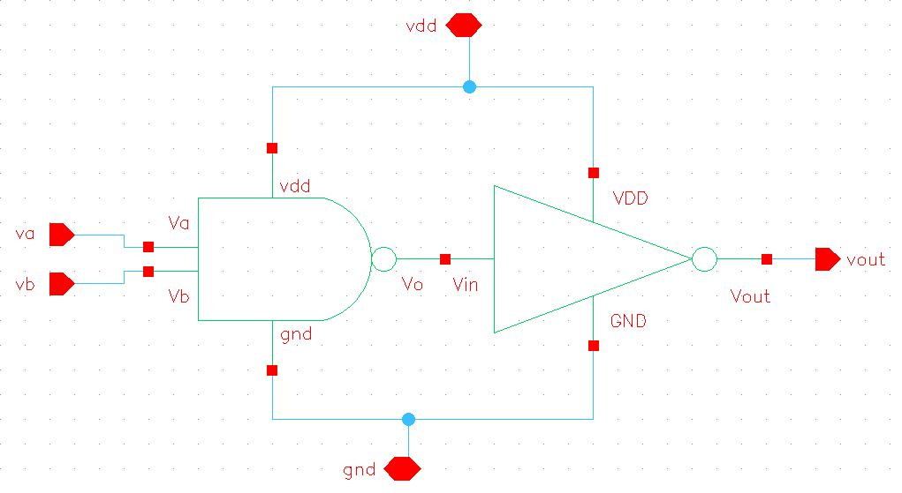
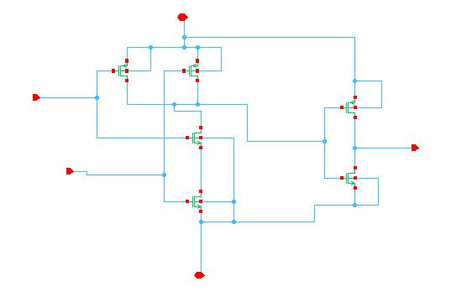
CMOS AND Schematic

Slide 20
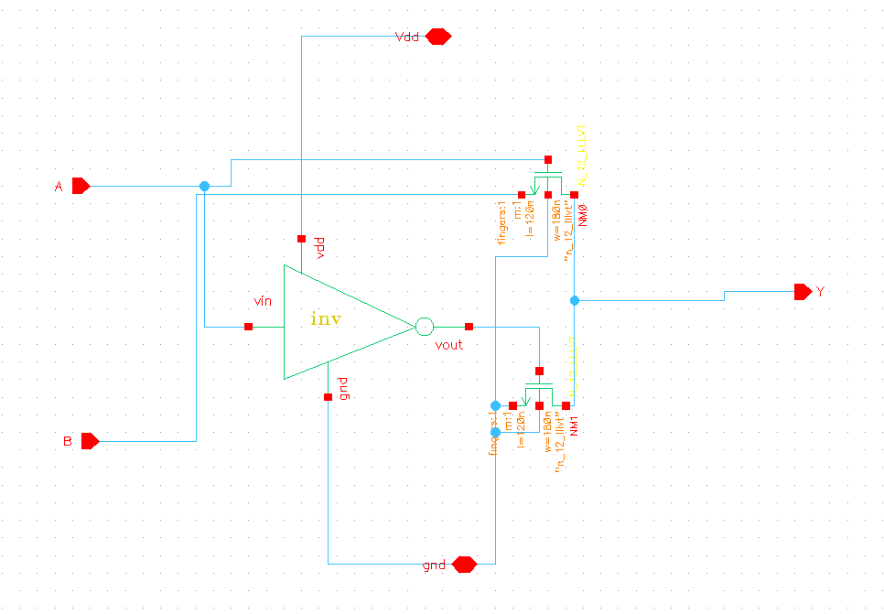
PTL AND Schematic

Slide 21
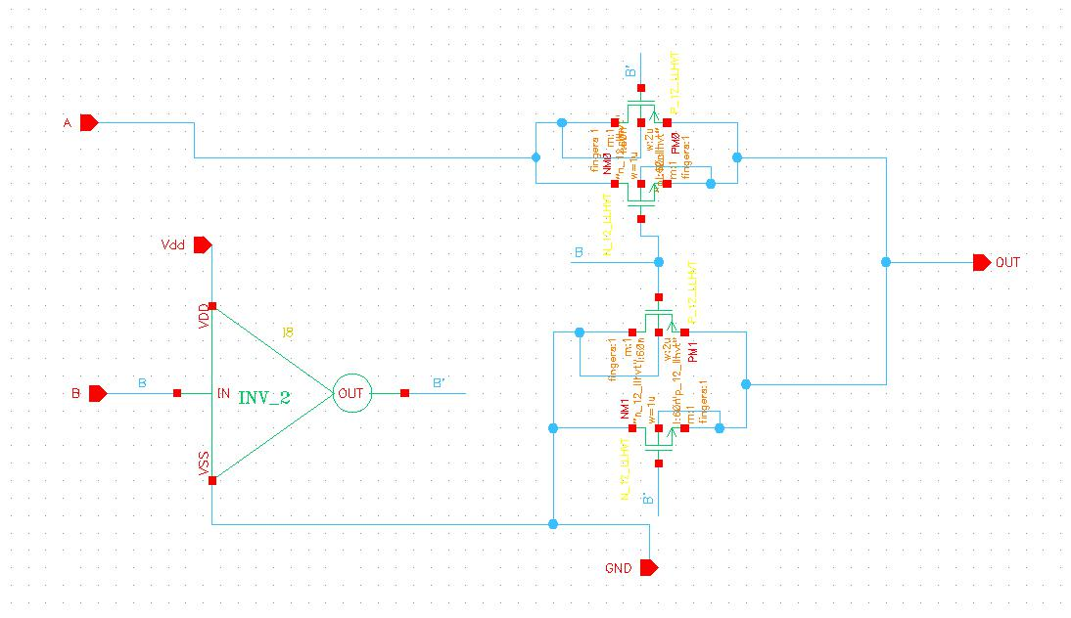
TG AND Schematic

Slide 22
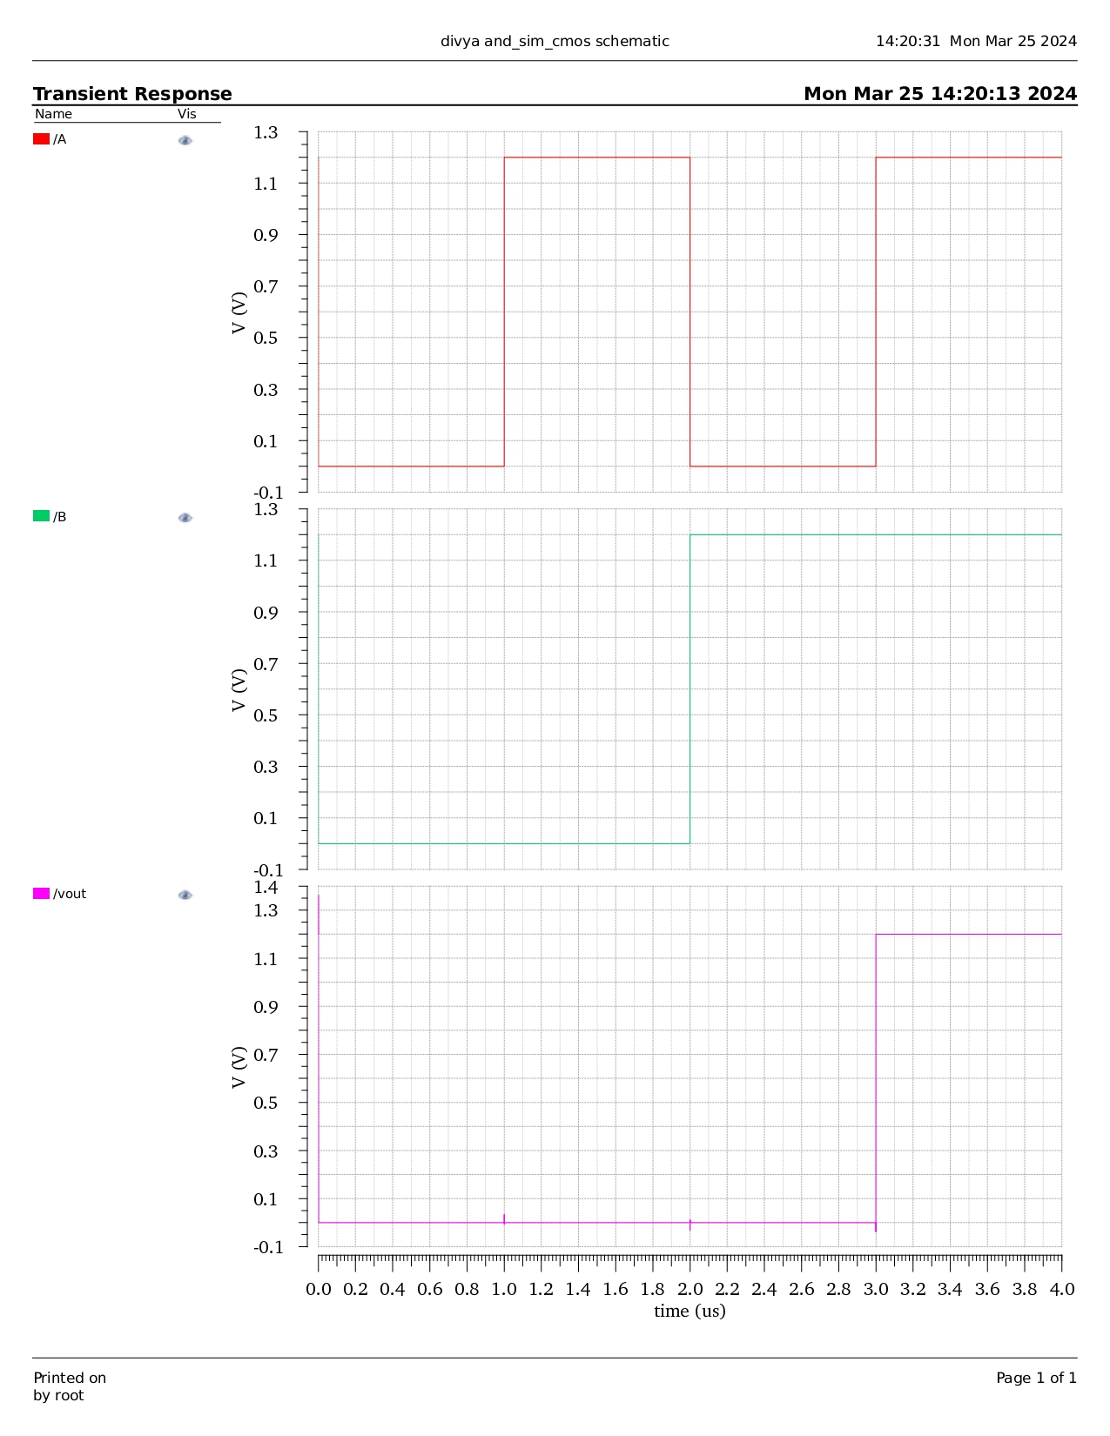
CMOS AND Waveform

Slide 23
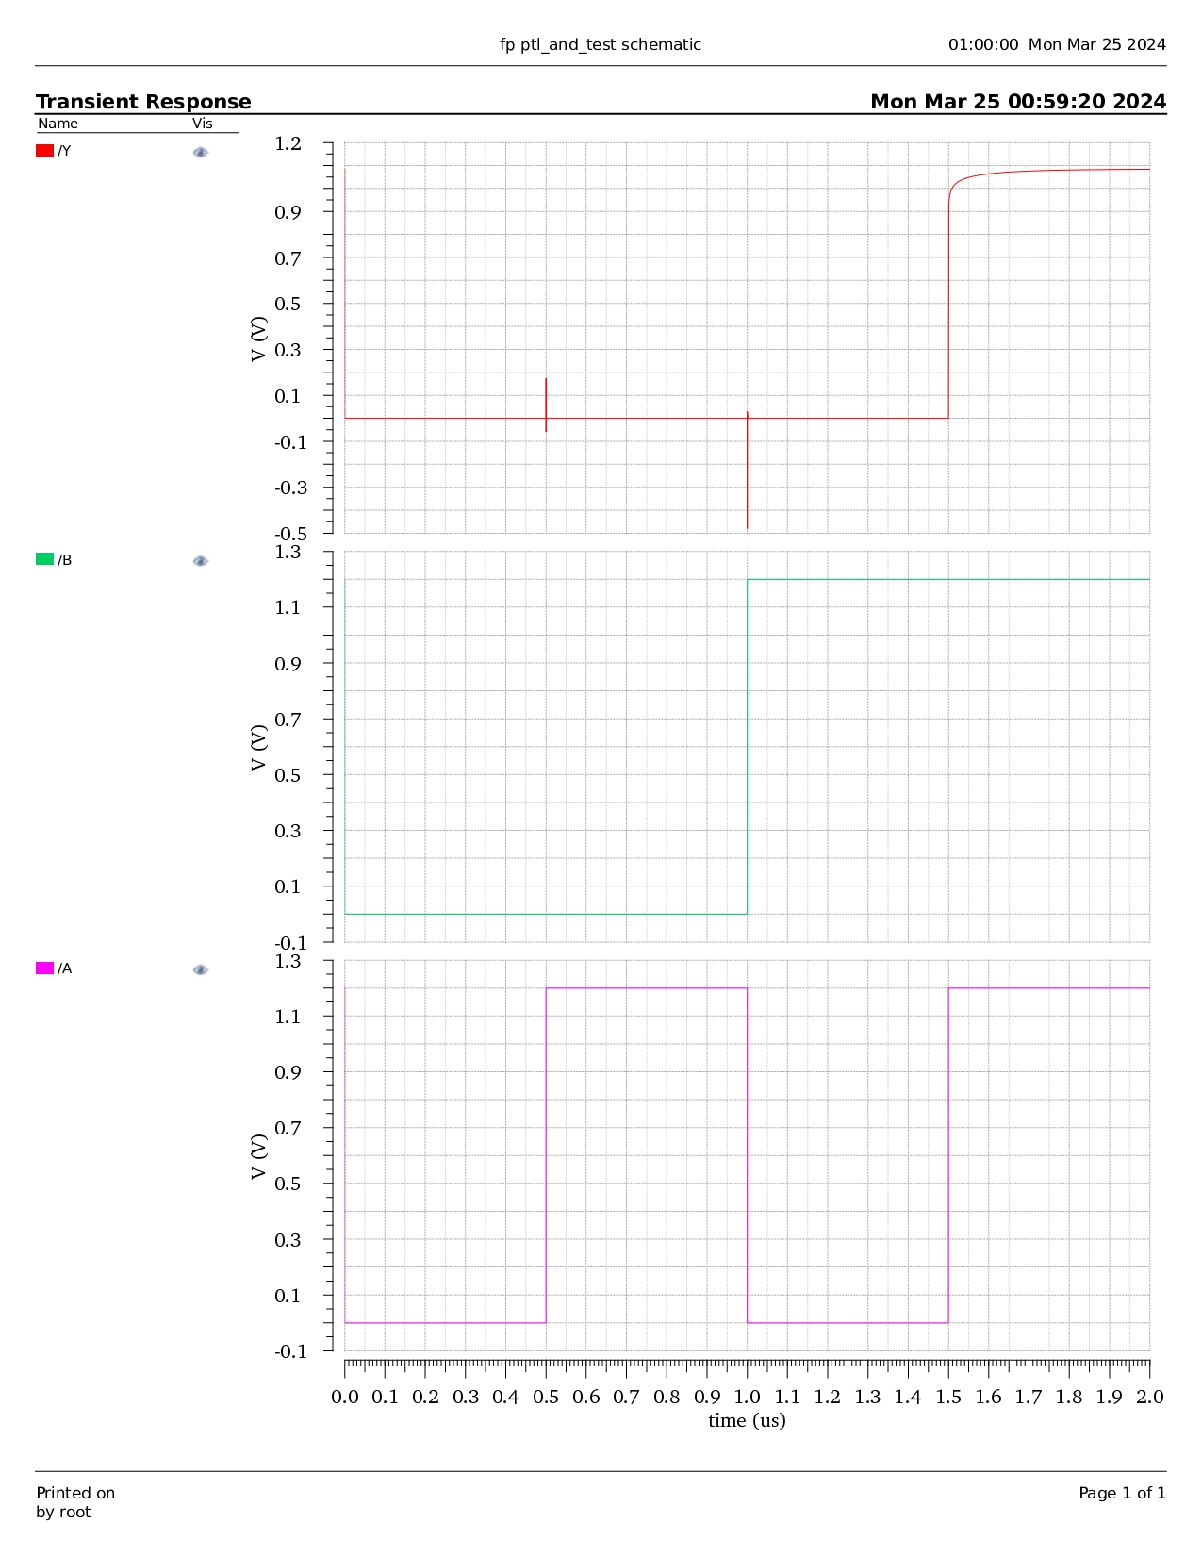
PTL AND Waveform

Slide 24
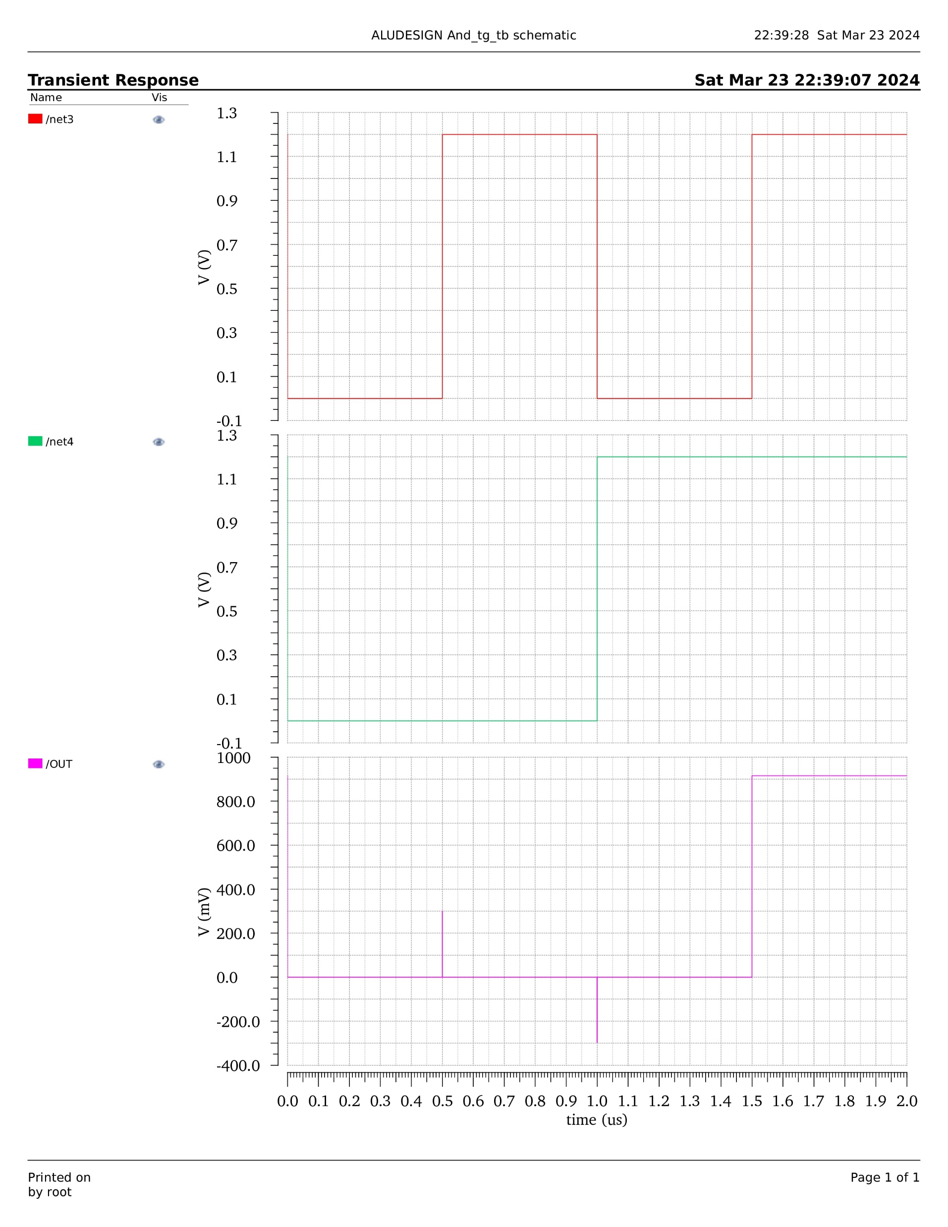
TG AND Waveform

Slide 25
Steps to calculate power
Navigate to the Tools tab in ADE after running the netlist.
Click on the Calculator option.
Select Clear Buffer, then click on "vt". Choose the positive terminal wire of Vdc, press Enter, and then select "It". Afterward, select Vdc's negative terminal (not the wire).
Now, choose the multiplication symbol and select Special Function -> integ on the Function panel. Input the maximum period value from the test bench.
Finally, execute the calculation by clicking on "evaluate buffer" located next to the clip.

Slide 26
Steps to calculate delay
Go to the Tools tab in ADE after running the netlist.
Click on the Calculator option.
Press Clear Buffer, then click on "vt". Choose one of the input's positive terminal wires, and paste the output to Signal 1 in the Function Panel. Then click on "vt" again, select the output wire, and paste it to Signal 2 in the Function Panel.
Select Special Function -> delay on the Function panel and input half the value of Vdc's voltage from the test bench.
Finally, execute the calculation by clicking on "evaluate buffer" located next to the clip.

Slide 27
AND Parameters
Technology | Power | Delay | PDP | No of transistors
CMOS | 6.601E-15 | 10.49E-12 | 692E-28 | 6
PTL | 3.463E-15 | 7.253E-12 | 251E-28 | 4
TG | 18.88E-15 | 0.015E-12 | 2.832E-28 | 6
PTL consumes less power than CMOS and TG for AND gate implementation.
TG produces less delay than CMOS and PTL for AND gate implementation.

Slide 28
OR
An OR gate is a digital logic gate that produces an output (often denoted as Q) when at least one of its inputs (denoted as A or B) is true or high. In other words, the output is true if either or both inputs are true. The OR gate's behavior can be expressed as follows: Q=A+B
A | B | O/P
0 | 0 | 0
0 | 1 | 1
1 | 0 | 1
1 | 1 | 1

Slide 29
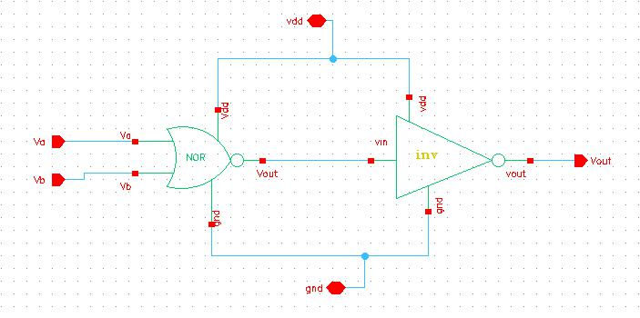
CMOS OR Schematic

Slide 30
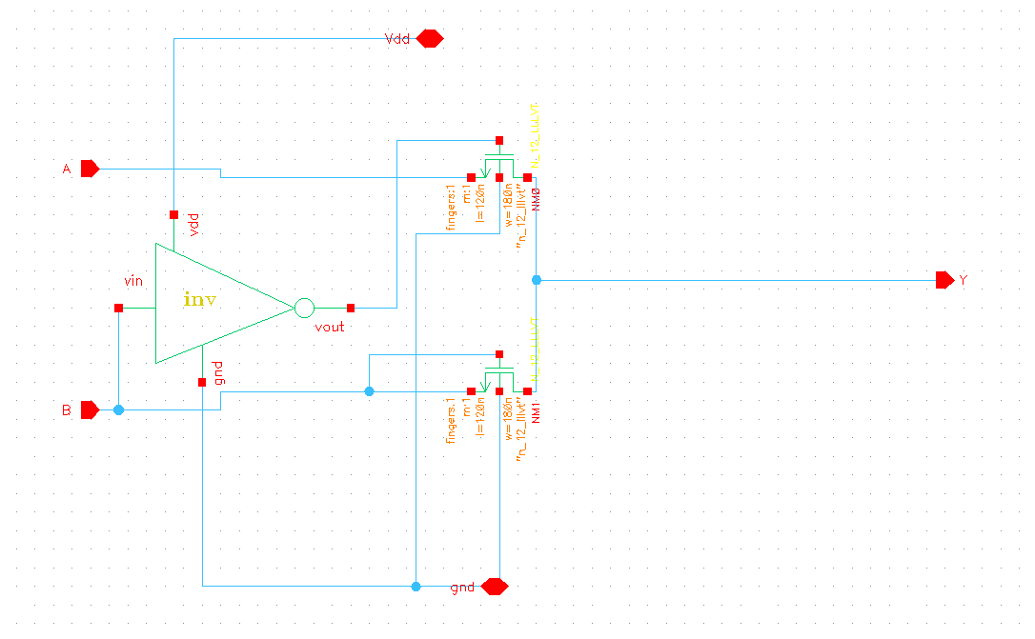
PTL OR Schematic

Slide 31
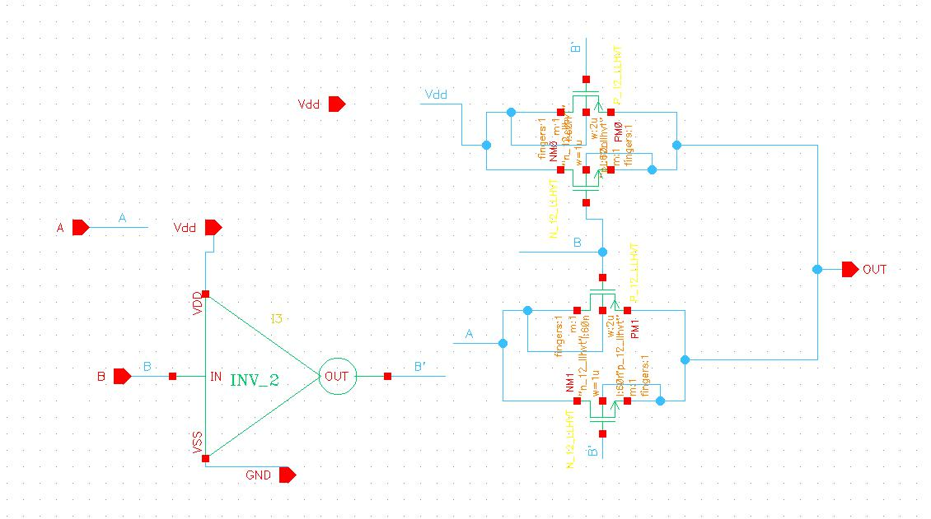
TG OR Schematic

Slide 32
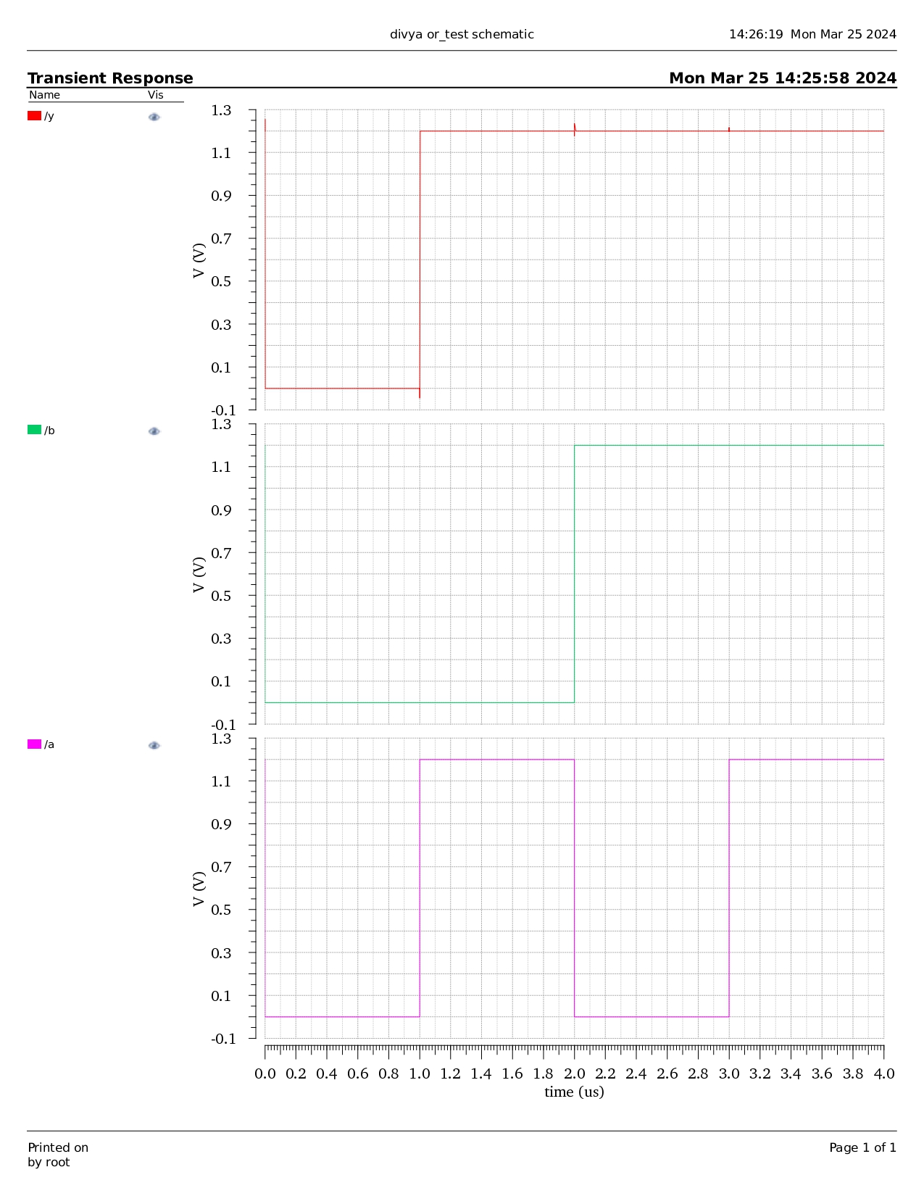
CMOS OR Waveform

Slide 33
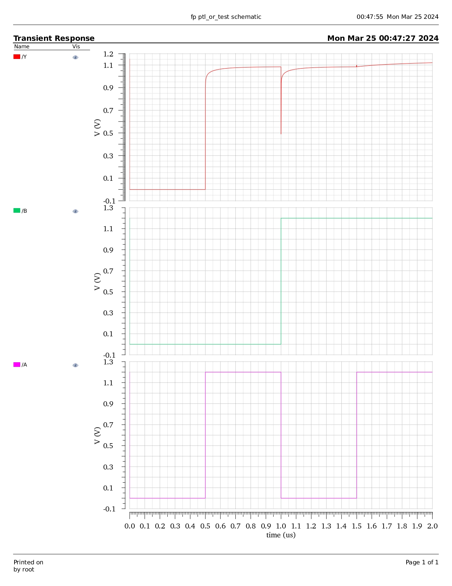
PTL OR Waveform

Slide 34
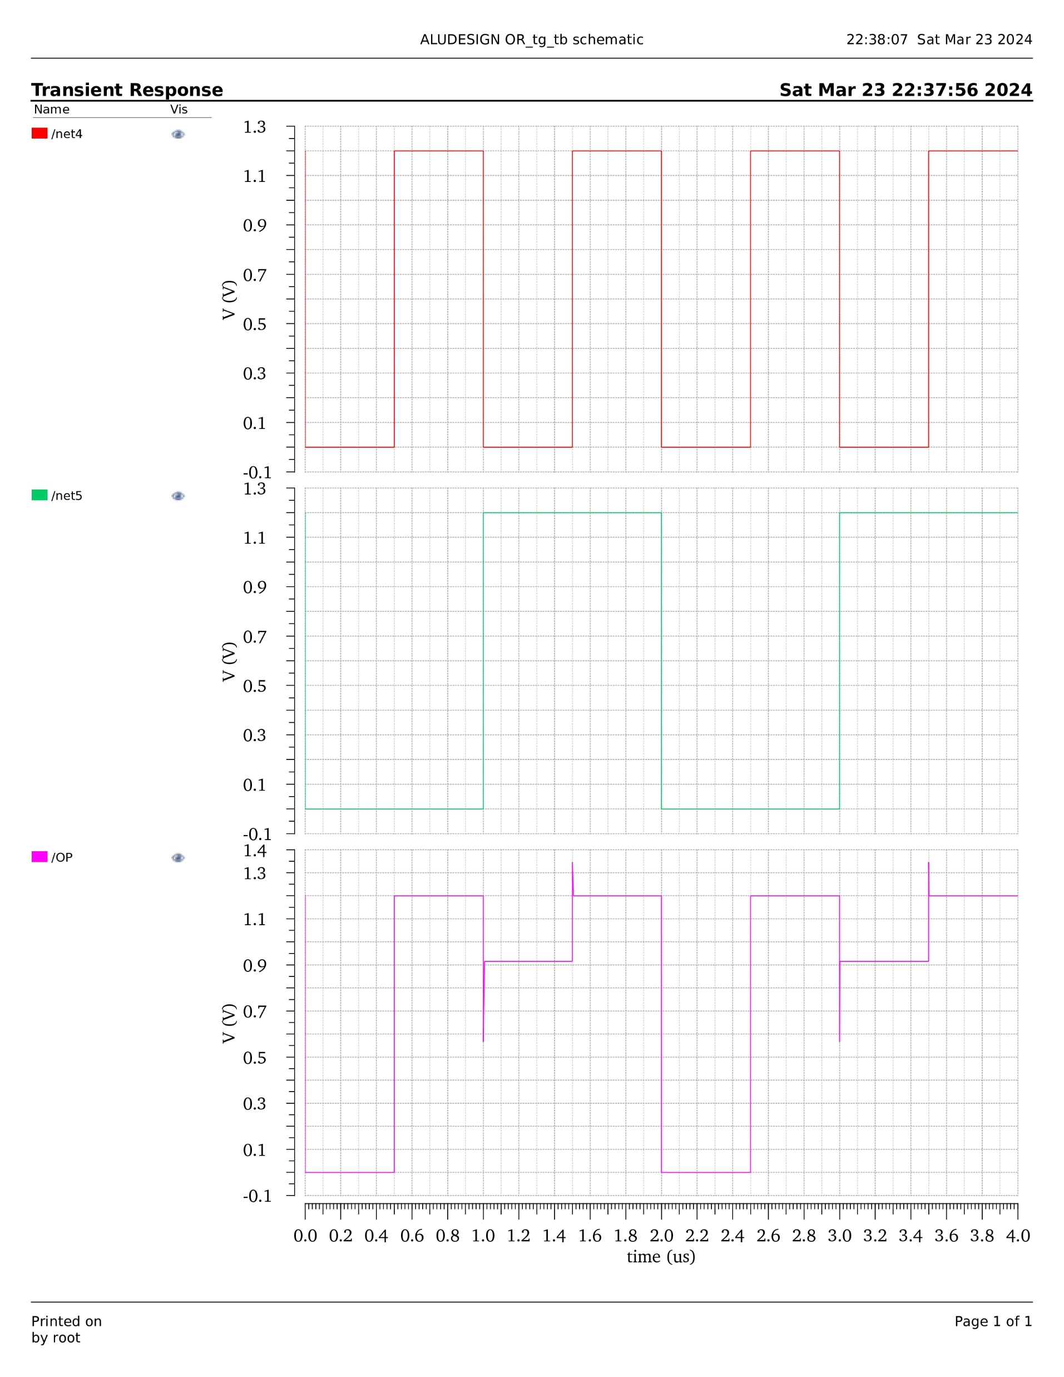
TG OR Waveform

Slide 35
OR
Technology | Power | Delay | PDP | No of transistors
CMOS | 0.0055E-12 | 25.46E-12 | 1400E-28 | 6
PTL | 0.0019E-12 | 7.906E-12 | 150.214E-28 | 4
TG | 135.6E-12 | 0.4598E-12 | 62.348E-24 | 6
PTL consumes less power than CMOS and TG for OR gate implementation.
TG produces less delay than CMOS and PTL for OR gate implementation.

Slide 36
XOR
A XOR gate, also known as an Exclusive OR gate, is a digital logic gate that produces an output (often denoted as Q) when exactly one of its inputs (denoted as A or B) is true or high. In other words, the output is true only if one input is true, but not both. The XOR gate's behavior can be expressed as follows: Q = A ⊕ B.
A | B | O/P
0 | 0 | 0
0 | 1 | 1
1 | 0 | 1
1 | 1 | 0

Slide 37
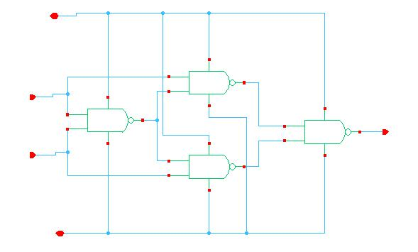
CMOS XOR Schematic

Slide 38
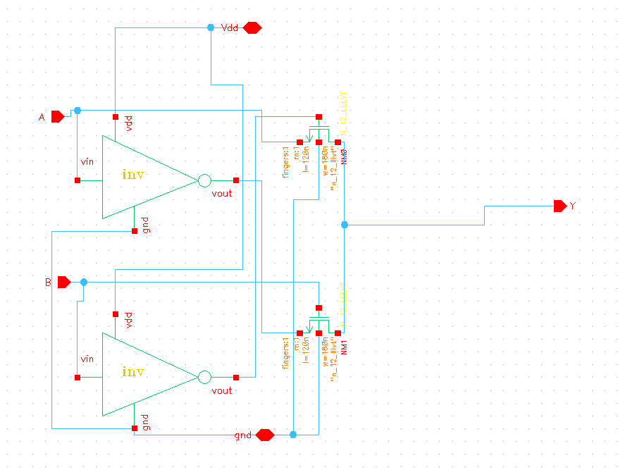
PTL XOR Schematic

Slide 39
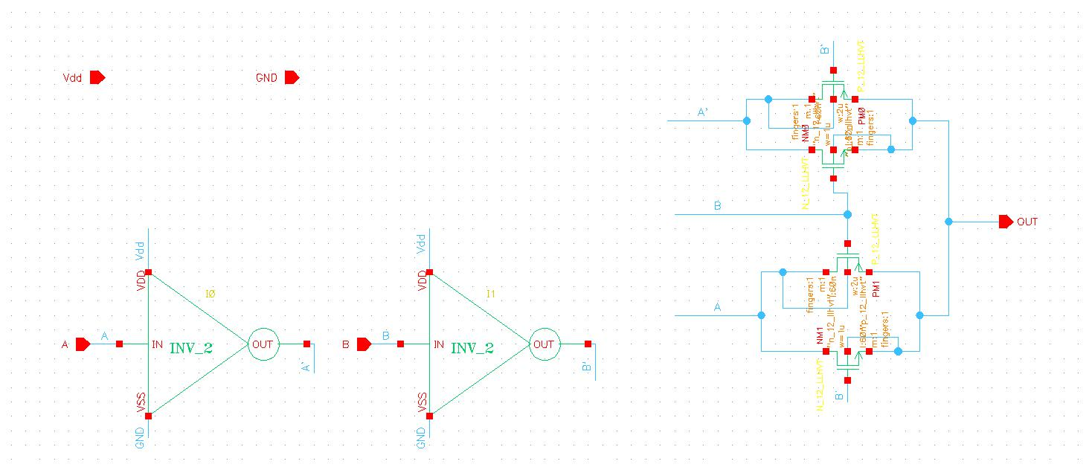
TG XOR Schematic

Slide 40
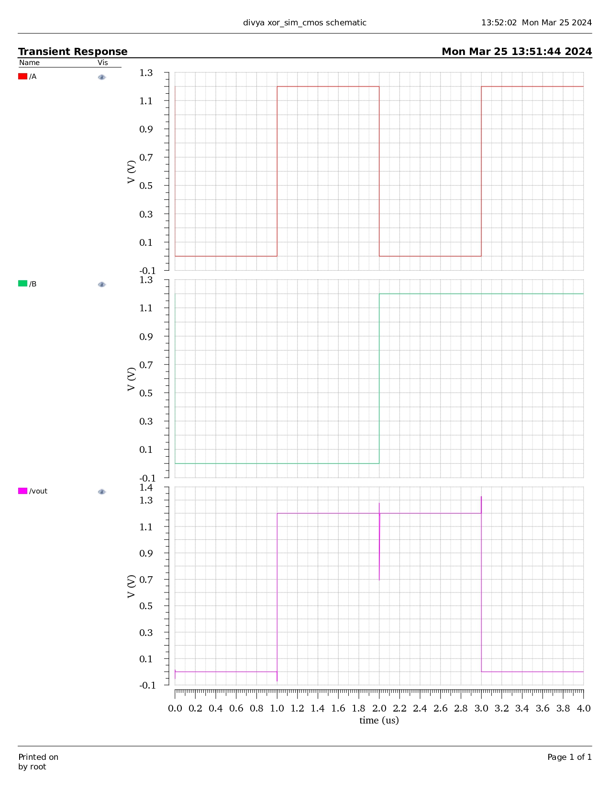
CMOS XOR Waveform

Slide 41
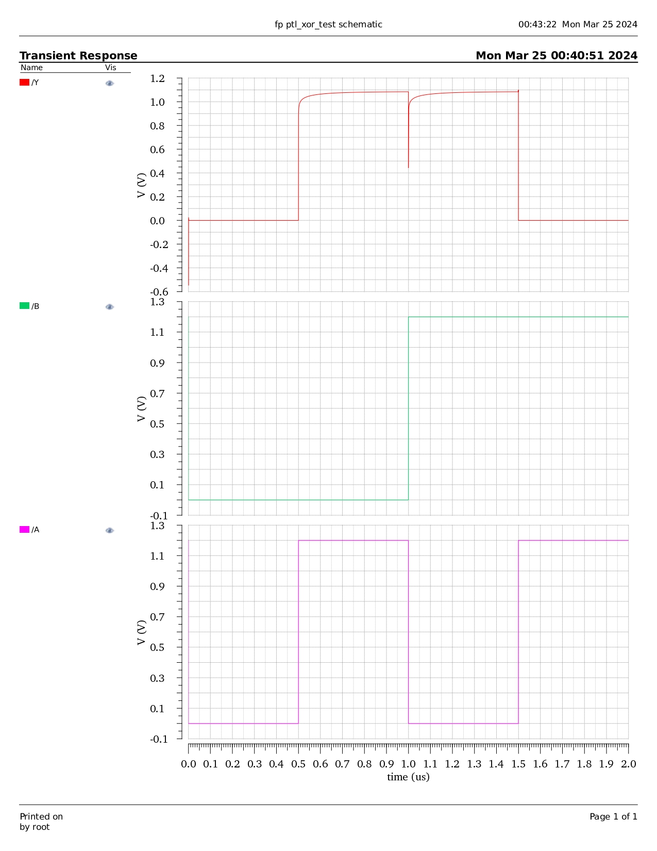
PTL XOR Waveform

Slide 42
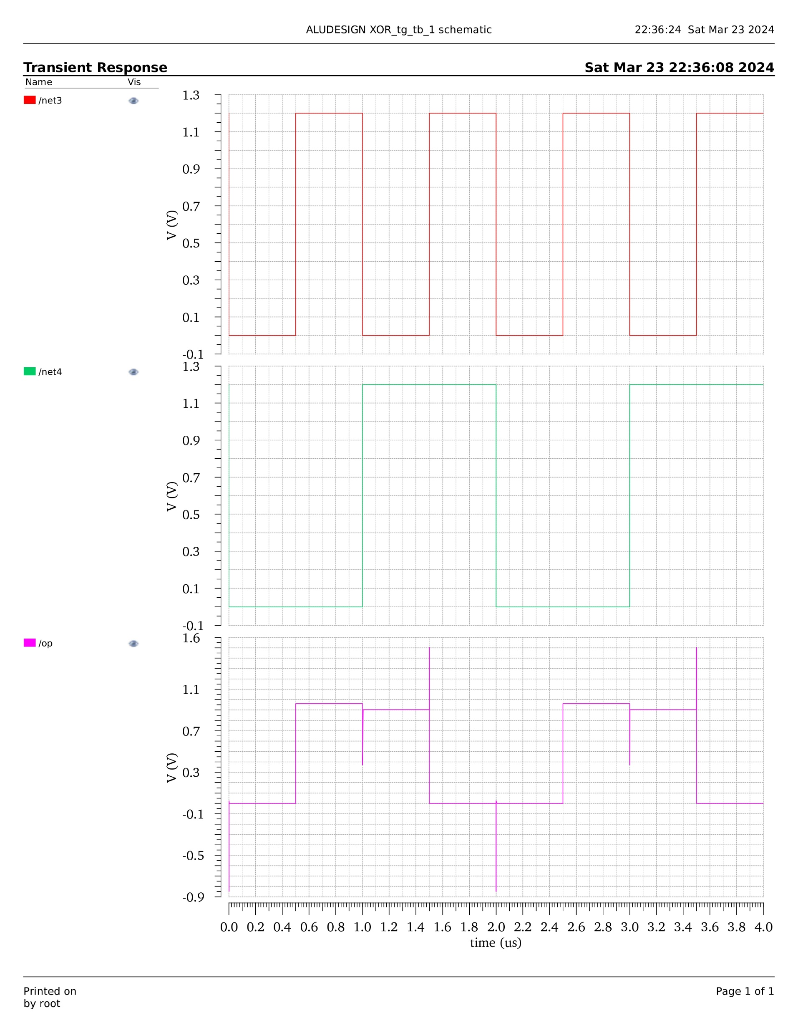
TG XOR Waveform

Slide 43
XOR
Technology | Power | Delay | PDP | No of transistors
CMOS | 5760000E-12 | 1000E-9 | 5.76E-12 | 16
PTL | 0.005096E-12 | 0.500E-9 | 2.548E-24 | 6
TG | 87.97E-12 | 500E-9 | 4398E-22 | 8
PTL consumes less power than CMOS and TG for XOR gate implementation.
PTL produces less delay than CMOS and TG for XOR gate implementation.

Slide 44
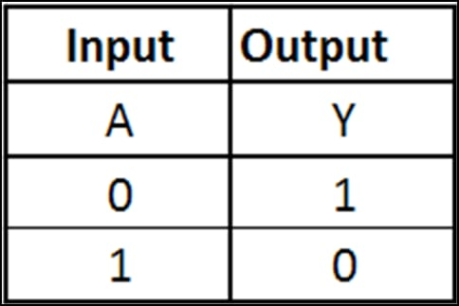
NOT
A NOT gate, also known as an inverter, is a digital logic gate that produces an output (often denoted as Q) that is the logical complement of its input (denoted as A). In simpler terms, it negates the input signal. The NOT gate's behavior can be expressed as follows: Q= A’

Slide 45
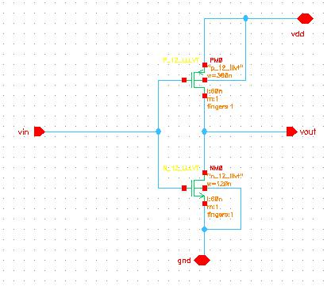
CMOS NOT Schematic

Slide 46
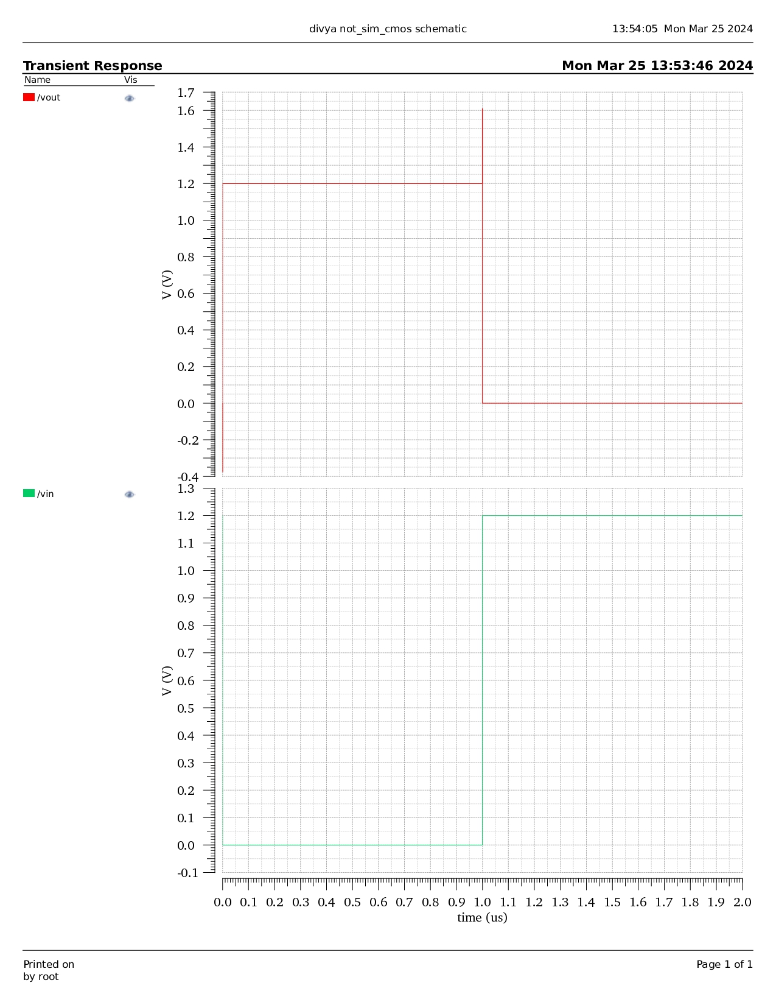
CMOS NOT Waveform

Slide 47
HALF ADDER
A half adder is a digital circuit that adds two single-bit binary numbers and produces the sum (S) and carry (C) as outputs. The half adder does not consider any previous carry from other addition operations. The expression for the sum (S) and carry (C) in terms of the input bits A and B is as follows: S=A⊕B and C=A⋅B
A | B | SUM | CARRY
0 | 0 | 0 | 0
0 | 1 | 1 | 0
1 | 0 | 1 | 0
1 | 1 | 0 | 1

Slide 48
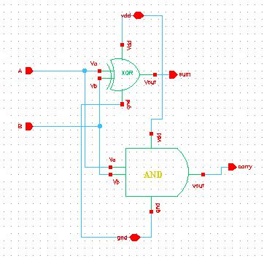
CMOS HA Schematic

Slide 49
FULL ADDER
A full adder is a digital circuit that adds two binary numbers along with a carry input and produces the sum (S) and carry (C) outputs. Unlike a half adder, a full adder considers the carry from the previous addition. The expressions for the sum (S) and carry (C) in terms of the input bits A, B, and the carry input (C in ) are as follows: S=A⊕B⊕C in and C out =(A⋅B)+(C in ⋅(A⊕B))
A | B | C | SUM | CARRY
0 | 0 | 0 | 0 | 0
0 | 0 | 1 | 1 | 0
0 | 1 | 0 | 1 | 0
0 | 1 | 1 | 0 | 1
1 | 0 | 0 | 1 | 0
1 | 0 | 1 | 0 | 1
1 | 1 | 0 | 0 | 1
1 | 1 | 1 | 1 | 1

Slide 50
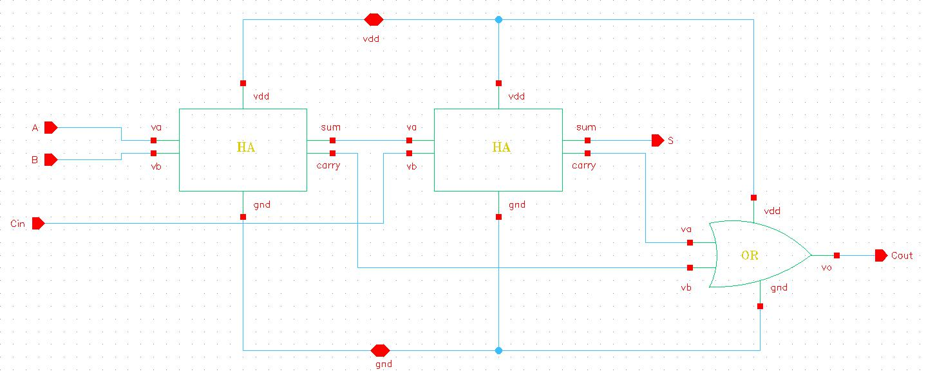
CMOS FA Schematic

Slide 51
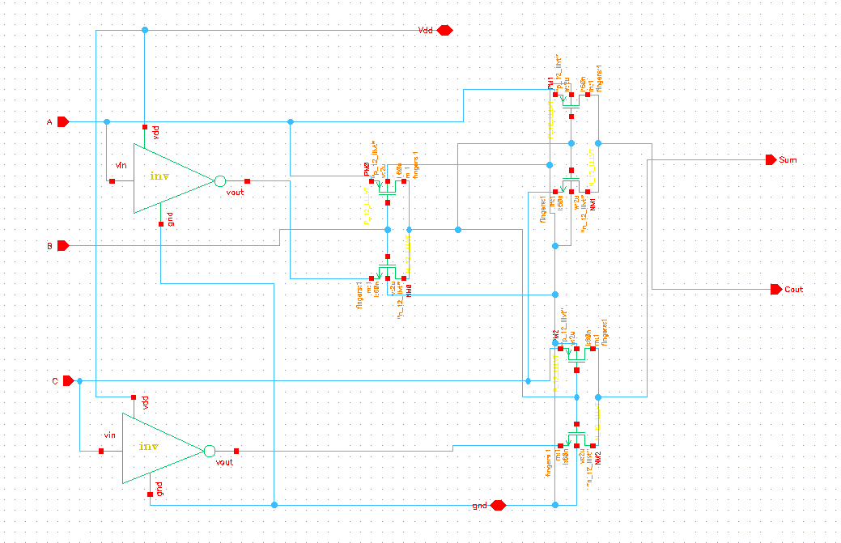
PTL FA Schematic

Slide 52
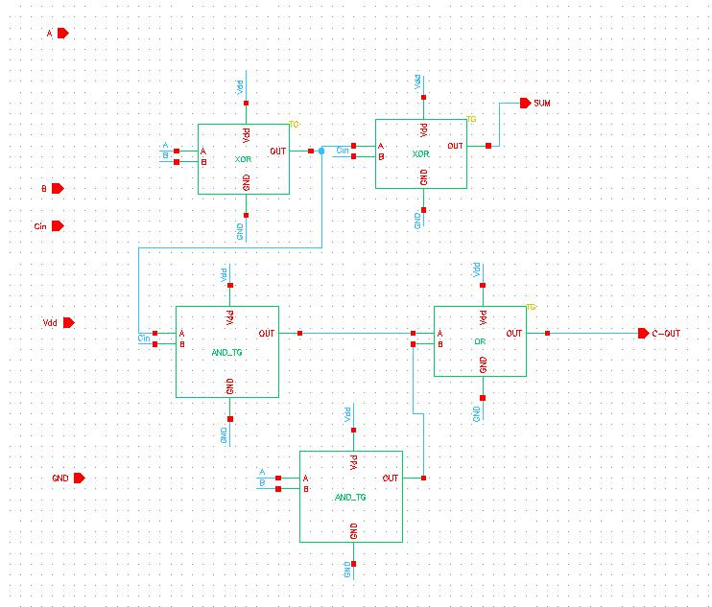
TG FA Schematic

Slide 53
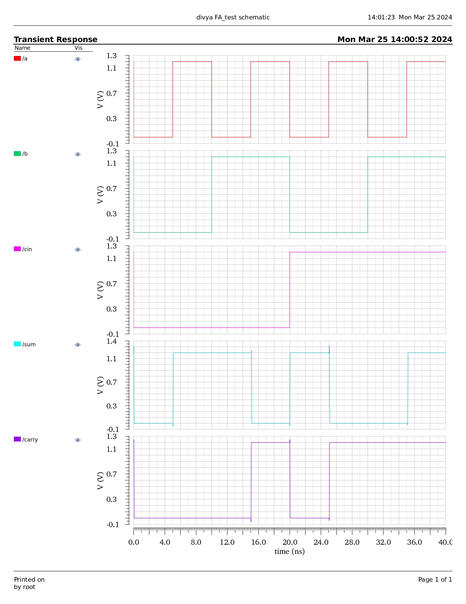
CMOS FA Waveform

Slide 54
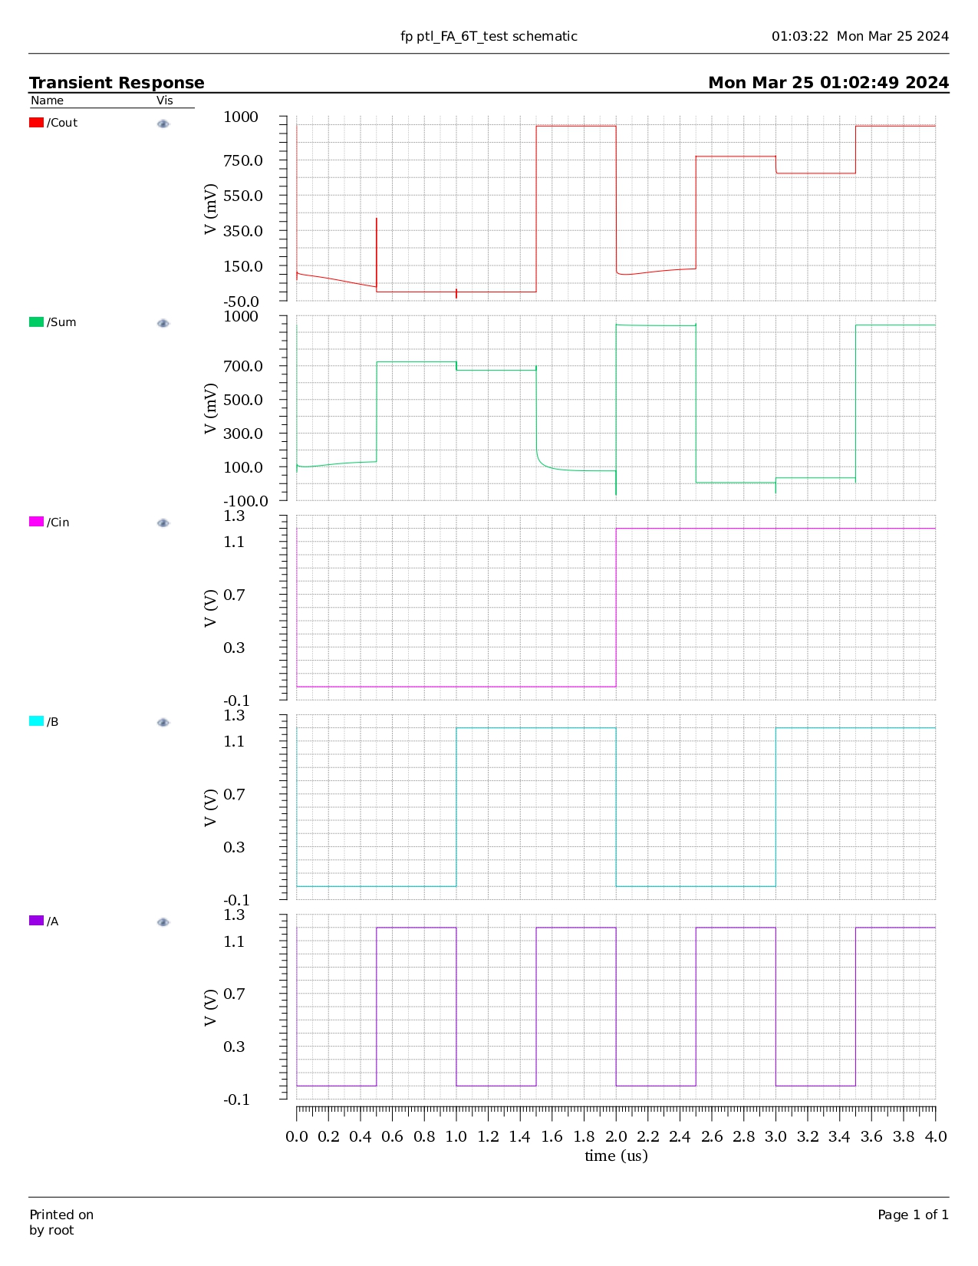
PTL FA Waveform

Slide 55
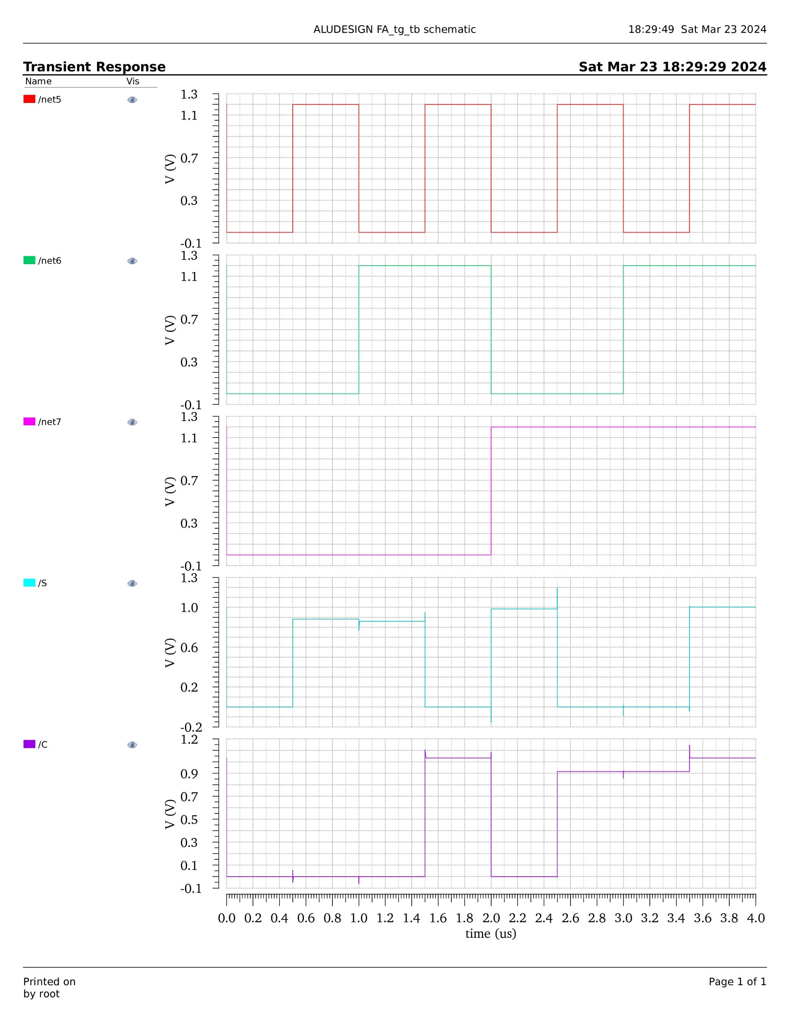
TG FA Waveform

Slide 56
FULL ADDER
Technology | Power | Delay | PDP | No of transistors
CMOS | 0.054E-12 | 38.78E-12 | 2.094E-24 | 50
PTL | 4.36E-12 | 0.272E-12 | 1.185E-24 | 6
TG | 502.9E-12 | 35.93E-12 | 1.806E-20 | 34
CMOS consumes less power than PTL and TG for FA implementation.
PTL produces less delay than CMOS and TG for FA implementation.

Slide 57
2X1 MULTIPLEXER
A 2X1 multiplexer, also known as a 2-to-1 multiplexer, is a digital circuit that selects one of two input data lines based on a control signal. It has two data inputs (usually labeled as D 0 and D 1 ), one output (Y), and a control input (S).The expression for the output Y in terms of the data inputs D 0 , D 1 , and the control signal S is given by: Y=(D0.S’ )+(D1 ⋅S) Here: Y is the output. D 0 and D 1 are the data inputs. S is the control input. S represents the logical NOT operation. The control input S determines which data input is routed to the output. If S is 0, D 0 is selected; if S is 1, D 1 is selected.
INPUTS | OUTPUTS
S0 | Y
0 | A0
1 | A1

Slide 58
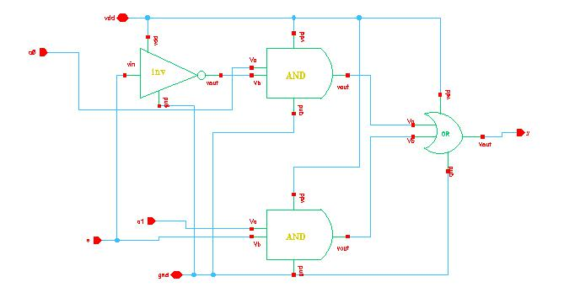
CMOS 2:1 Mux Schematic

Slide 59
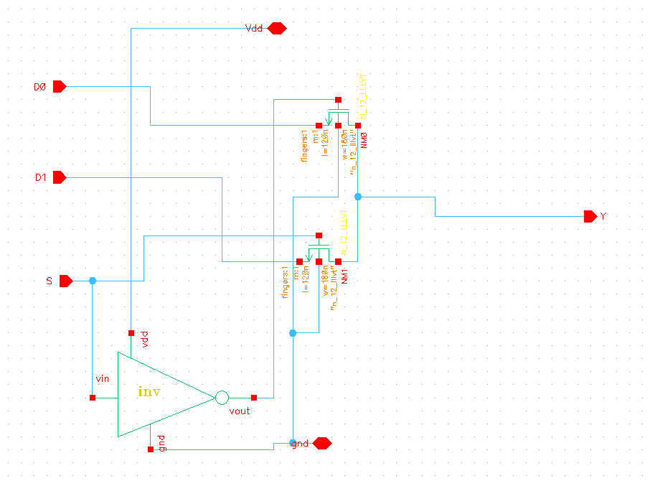
PTL 2:1 Mux Schematic

Slide 60
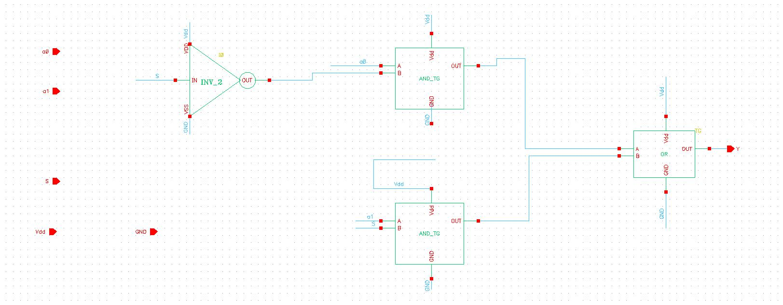
TG 2:1 Mux Schematic

Slide 61
CMOS 2:1 Mux Waveform

Slide 62
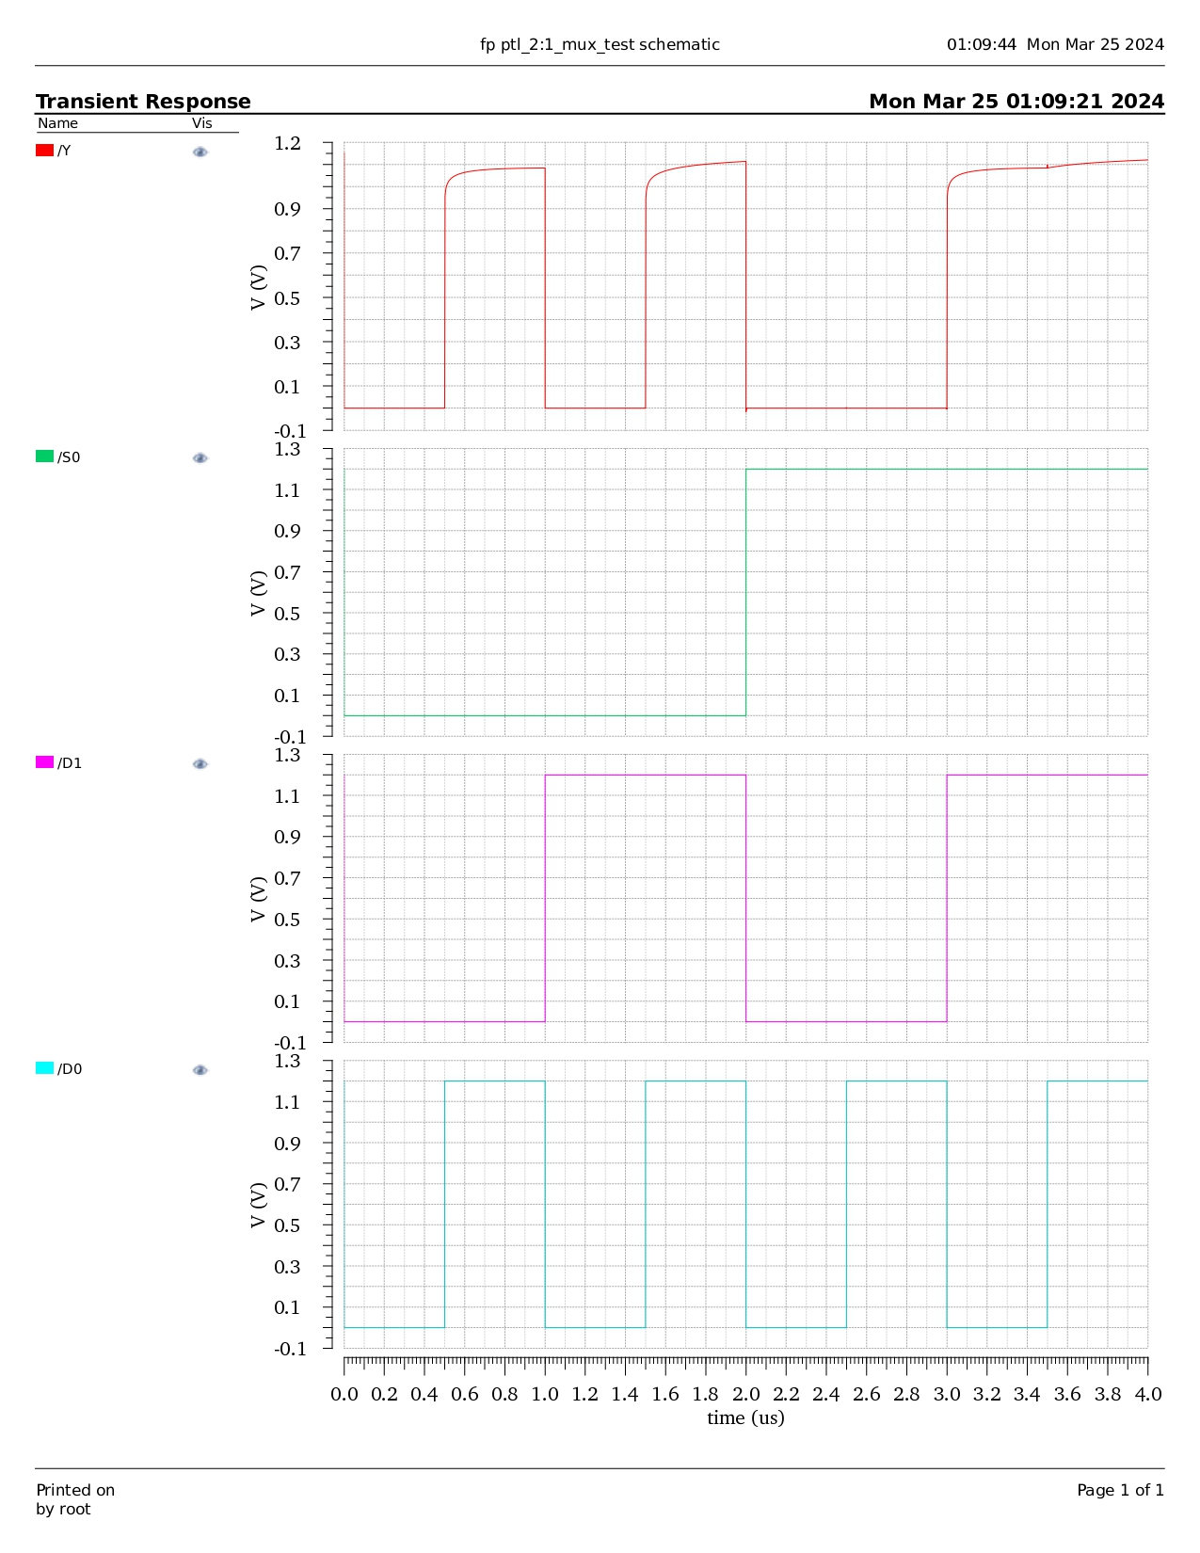
PTL 2:1 Mux Waveform

Slide 63
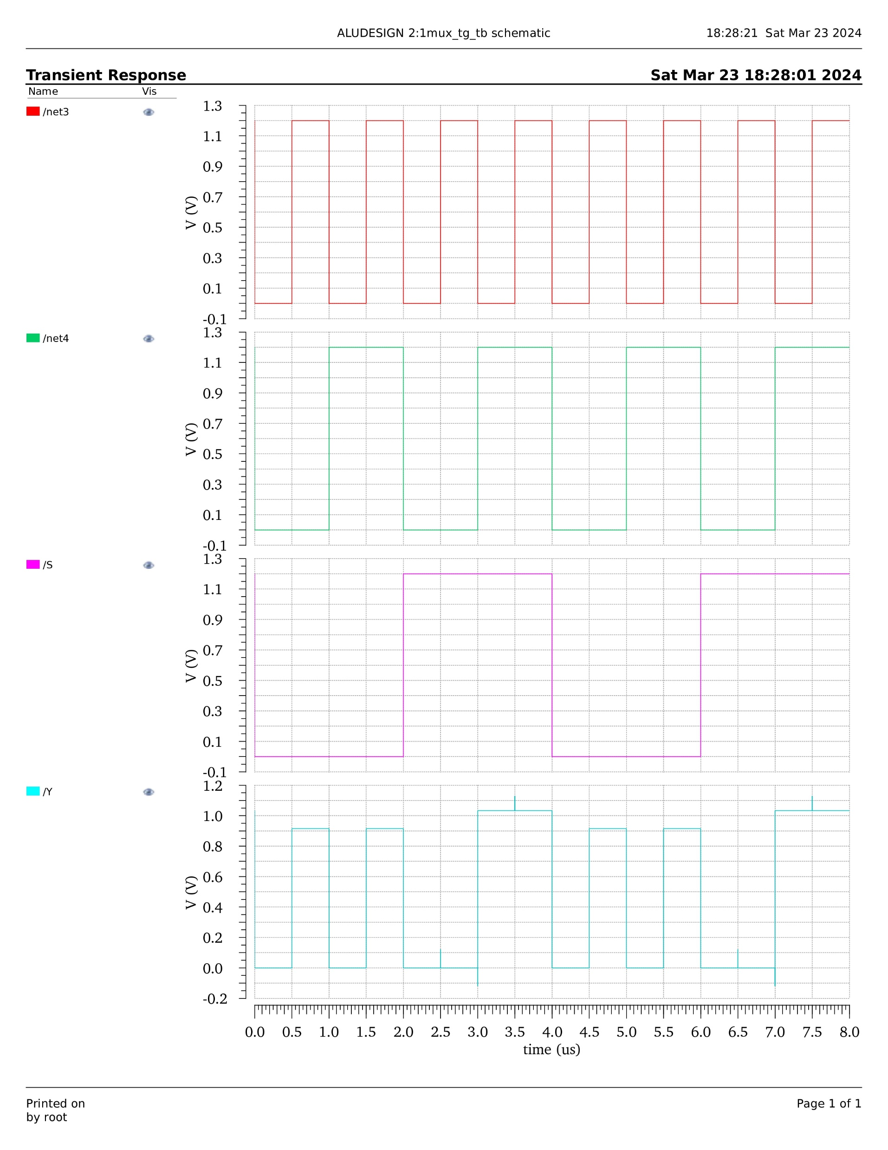
TG 2:1 Mux Waveform

Slide 64
2:1 MUX
Technology | Power | Delay | PDP | No of transistors
CMOS | 0.021E-12 | 38.77E-12 | 81E-28 | 20
PTL | 0.002E-12 | 7.901E-12 | 158E-28 | 4
TG | 188.8E-12 | 36.45E-12 | 68E-24 | 20
PTL consumes less power than CMOS and TG for 2:1 Mux implementation.
PTL produces less delay than CMOS and TG for 2:1 Mux implementation.

Slide 65
4X1 MULTIPLEXER
A 4X1 multiplexer selects one of four input lines (D 0 to D 3 ) based on two control inputs (S 1 and S 0 ). The output (Y) is determined by the selected input according to the control signals. The expression is given by Y= (D 0 .S 1’ .S 0’)+(D 1.S 1’.S 0)+(D 2. S 1.S 0’) +(D 3. S 1. S 0)
INPUTS | OUTPUTS
S0 | Y
0 | A0
1 | A1

Slide 66
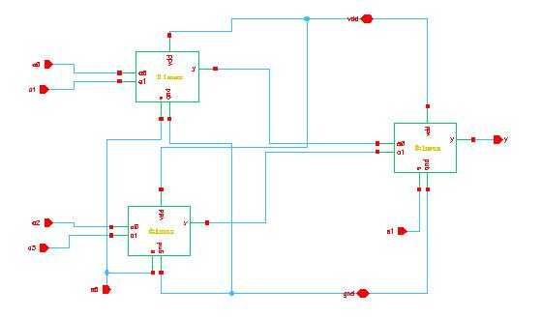
CMOS 4:1 Mux Schematic

Slide 67
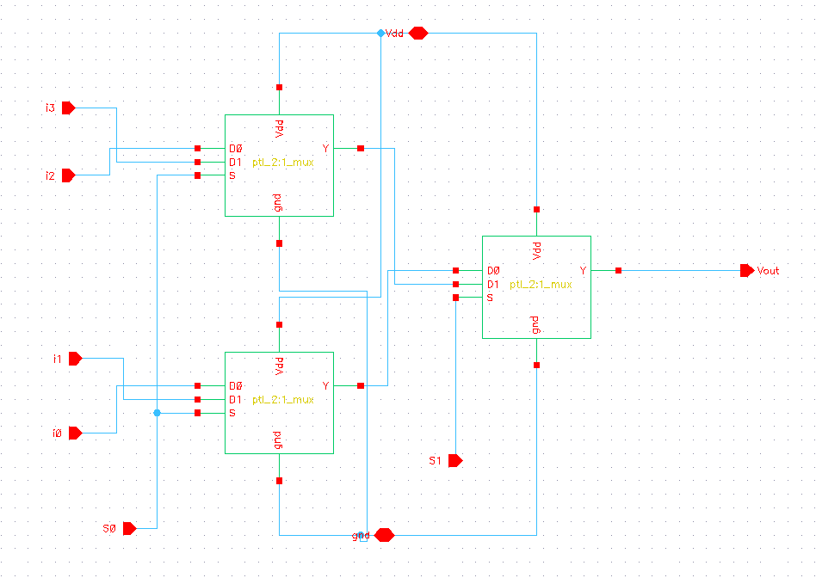
PTL 4:1 Mux Schematic

Slide 68
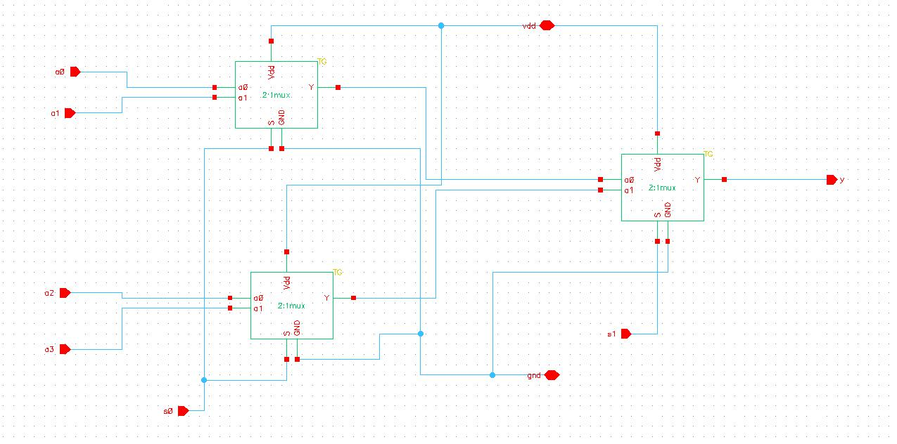
TG 4:1 Mux Schematic

Slide 69
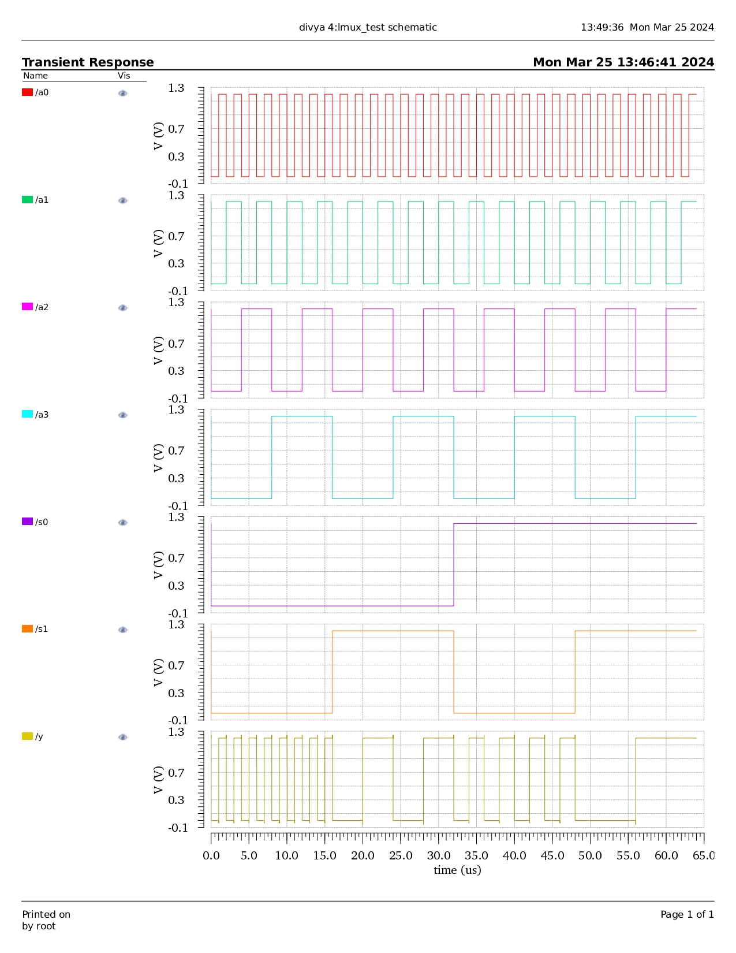
CMOS 4:1 Mux Waveform

Slide 70
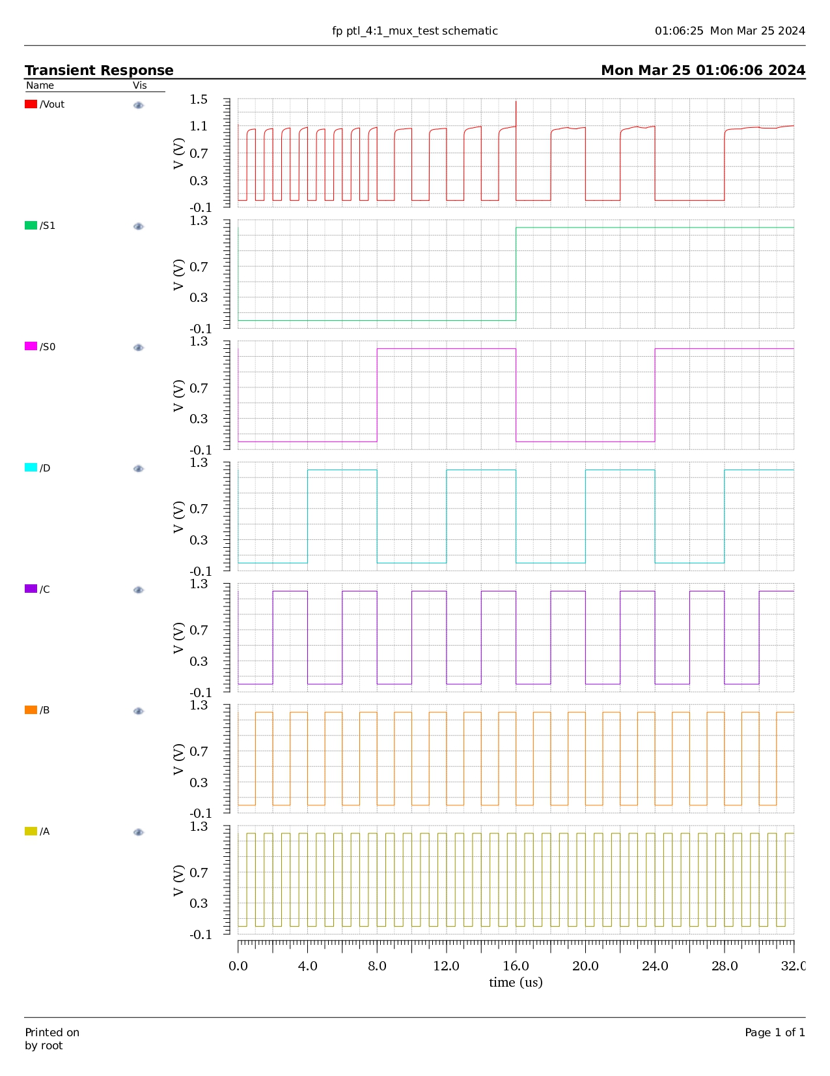
PTL 4:1 Mux Waveform

Slide 71
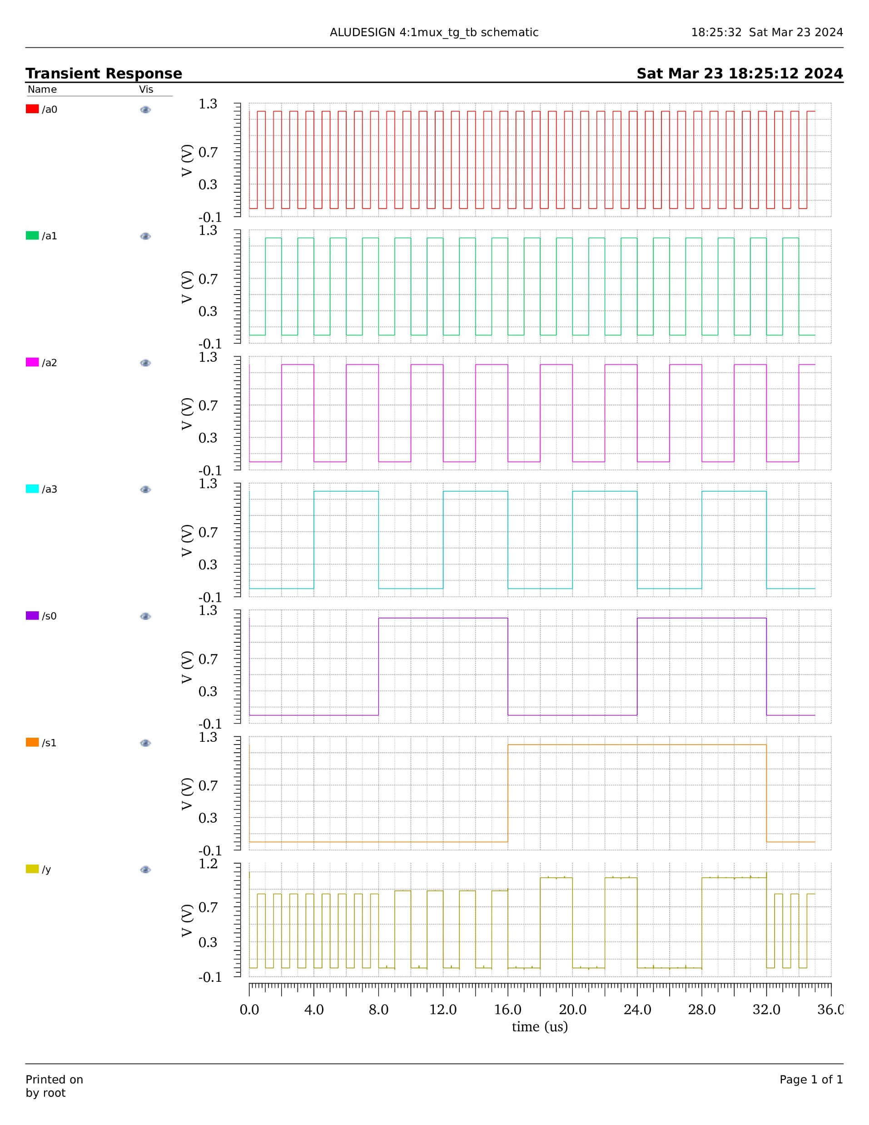
TG 4:1 Mux Waveform

Slide 72
4:1 MUX
Technology | Power | Delay | PDP | No of transistors
CMOS | 0.000996E-9 | 46.44E-12 | 46.25E-24 | 60
PTL | 0.000050E-9 | 15.52E-12 | 77E-28 | 12
TG | 4.851E-9 | 60.8E-12 | 29.4E-20 | 60
PTL consumes less power than CMOS and TG for 4:1 Mux implementation.
PTL produces less delay than CMOS and TG for 4:1 Mux implementation.

Slide 73
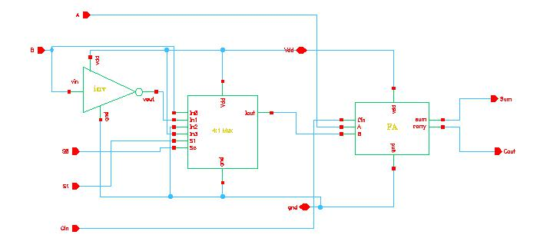
CMOS Arithmetic Schematic

Slide 74
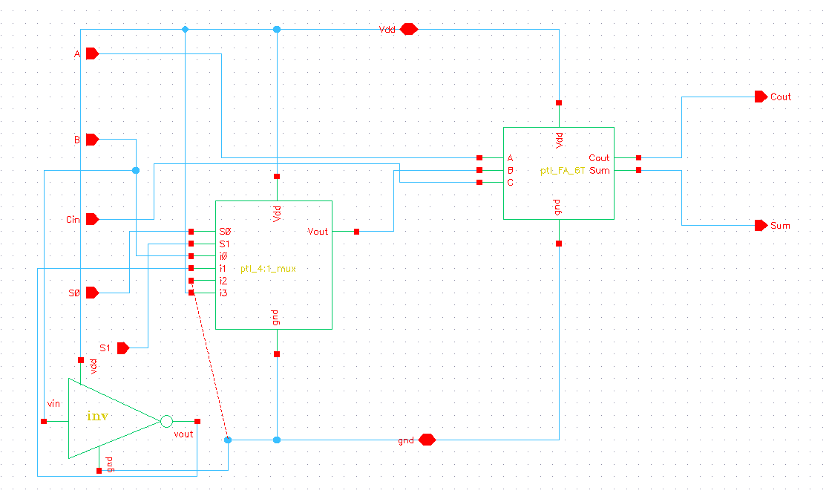
PTL Arithmetic Schematic

Slide 75
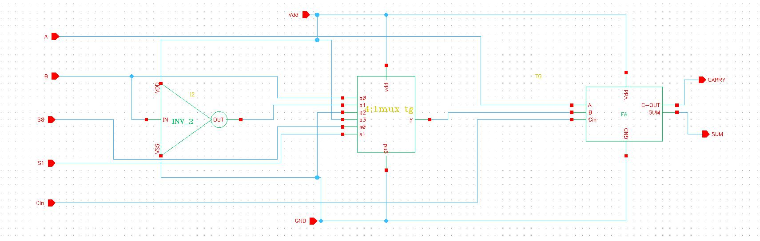
TG Arithmetic Schematic

Slide 76
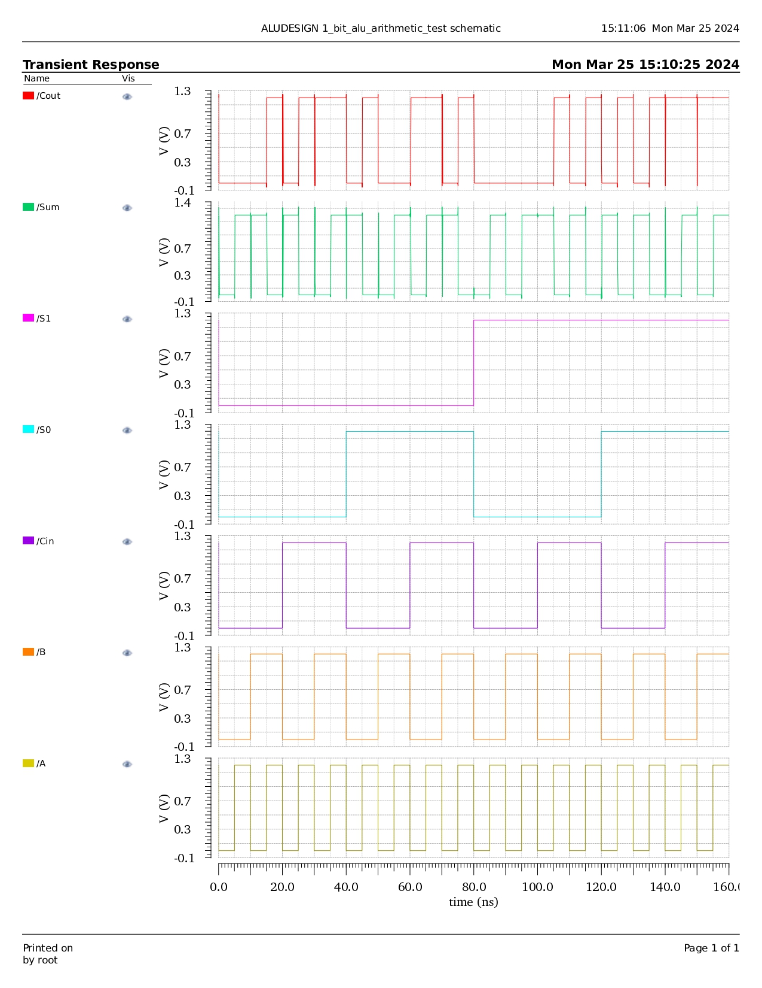
CMOS Arithmetic Unit Waveform

Slide 77
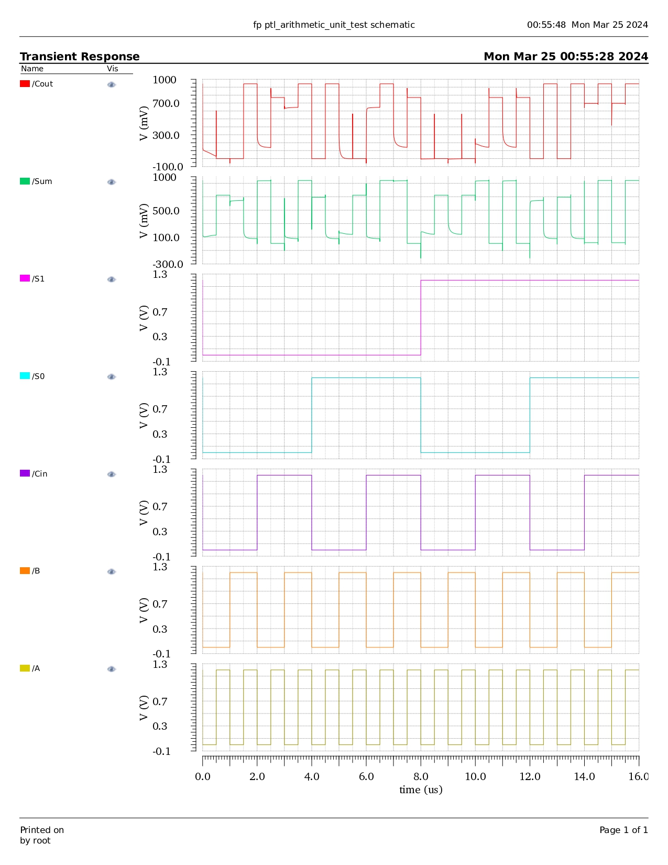
PTL Arithmetic Unit Waveform

Slide 78
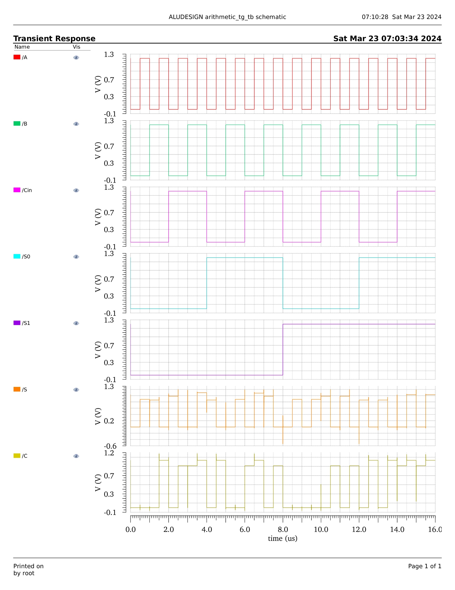
TG Arithmetic Unit Waveform

Slide 79
ARITHMETIC
Technology | Power | Delay | PDP | No of transistors
CMOS | 0.00048E-9 | 0.04315E-9 | 20.712E-24 | 110
PTL | 0.05557E-9 | 0.000453E-9 | 25.17321E-24 | 20
TG | 8.096E-9 | 0.03334E-9 | 26.992E-20 | 96
CMOS consumes less power than PTL and TG for Arithmetic Unit implementation.
PTL produces less delay than CMOS and TG for Arithmetic Unit implementation.

Slide 80
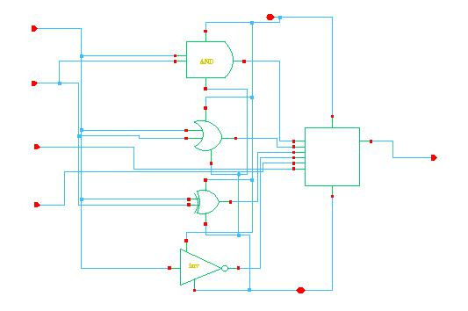
CMOS Logical Unit Schematic

Slide 81
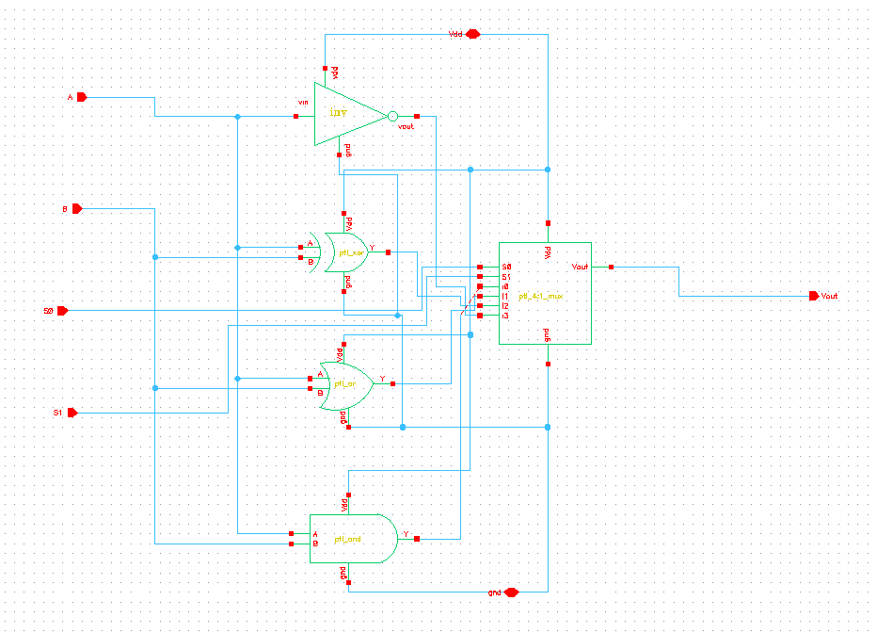
PTL Logical Unit Schematic

Slide 82
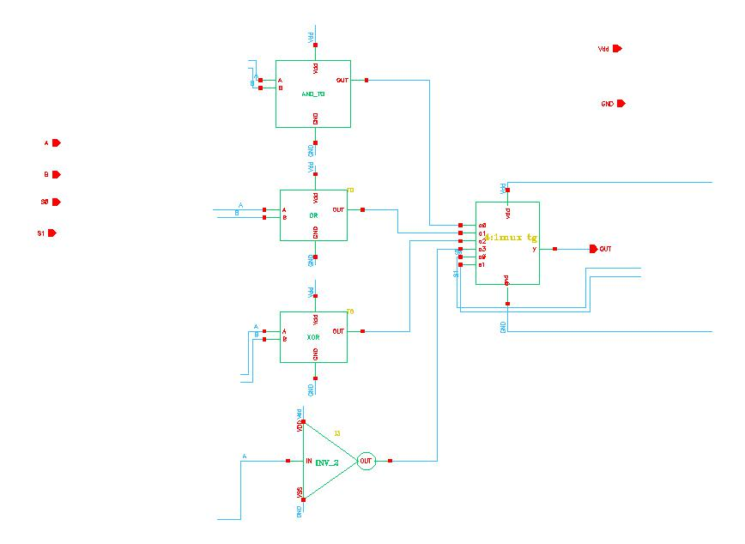
TG Logical Unit Schematic

Slide 83

CMOS Logical Unit Waveform

Slide 84

PTL Logical Unit Waveform

Slide 85

TG Logical Unit Waveform

Slide 86
LOGICAL
Technology | Power | Delay | PDP | No of transistors
CMOS | 0.000228E-9 | 65.05E-12 | 14.83E-24 | 90
PTL | 0.000074E-9 | 1500000E-12 | 11.1E-20 | 28
TG | 2.821E-9 | 1500000E-12 | 42.315E-16 | 82
PTL consumes less power than CMOS and TG for Logical Unit implementation.
CMOS produces less delay than PTL and TG for Logical Unit implementation.

Slide 87

CMOS 1 bit ALU Schematic

Slide 88
PTL 1 bit ALU Schematic

Slide 89

TG 1 bit ALU Schematic

Slide 90

CMOS 1 bit ALU Waveform

Slide 91

PTL 1 bit ALU Waveform

Slide 92

TG 1 bit ALU Waveform

Slide 93
ONE BIT ALU
Technology | Power | Delay | PDP | No of transistors
CMOS | 0.009E-9 | 0.043E-9 | 387E-24 | 260
PTL | 0.222E-9 | 500E-9 | 1.11E-16 | 50
TG | 58.85E-9 | 0.033E-9 | 194.2E-20 | 238
CMOS consumes less power than PTL and TG for 1 bit ALU implementation.
TG produces less delay than PTL and TG for 1 bit ALU implementation.

Slide 94

CMOS 4 bit ALU Schematic

Slide 95

PTL 4 bit ALU Schematic

Slide 96

TG 4 bit ALU Schematic

Slide 97

CMOS 4 bit ALU Waveform

Slide 98

PTL 4 bit ALU Waveform

Slide 99
TG 4 bit ALU Waveform

Slide 100
Comparison of 4-bit ALU in various technologies
Technology | Power | Delay | PDP | No of transistors
CMOS | 743E-12 | 3050E-12 | 226.615E-20 | 1040
PTL | 398E-12 | 1114E-12 | 44.37E-20 | 200
TG | 300800E-12 | 5280E-12 | 15.882E-16 | 952
PTL consumes less power than the conventional CMOS and TG for 4-bit ALU implementation.
PTL produces less delay than CMOS and TG for 4-bit ALU implementation.

Slide 101
Proposed High Performance 4-bit Hybrid ALU
changed the logical block in 1-bit alu with AND gate (TG), Or gate (TG), XOR gate (PTL), 4:1 MUX (PTL) which were best in terms of delay and made a 4-bit hybrid alu.
POWER | DELAY | PDP | No of transistors
14.16E-9 | 1056E-12 | 1495E-20 | 256

Slide 102
Proposed Low Power 4-bit Hybrid ALU
Changed the arithmetic block in 1-bit alu with FA (CMOS) and 4:1 MUX(PTL) which were best in terms of power and made a 4-bit hybrid alu
POWER | DELAY | PDP | No of transistors
237E-12 | 1104E-12 | 26E-20 | 408

Slide 103
Comparison of Parameters
Technology | Power | Delay | PDP | No of transistors
Base Paper (CMOS) | 743E-12 | 3050E-12 | 226.615E-20 | 1040
PTL | 398E-12 | 1114E-12 | 44.37E-20 | 200
Hybrid-1 | 14.16E-9 | 1056E-12 | 1495E-20 | 256
Hybrid-2 | 237E-12 | 1104E-12 | 26E-20 | 408
Our Hybrid models outperform both in terms of Power Consumption & Delay production than the PTL implementation.
Thus, leads to better PDP (Power Delay Product).

Slide 104
Conclusion
In this project a 4-bit alu is designed using different logics like CMOS, pass transistor logic, Transmission gate logic have been implemented which involves designing of the individual modules like AND, OR, XOR, FA, 2:1 MUX, 4:1 MUX, ARITHMETIC UNIT, LOGICAL UNIT, 1-BIT ALU, 4-BIT ALU All the proposed ALU are designed in a cadence virtuoso environment using 65nm technology pdk tool kit with a supply voltage of 1.2V. All the circuits are simulated and their functional analysis is done. Parameters results are tabulated (power, delay, power delay product, transistor count) and are compared with each other then finally the best designs for particular parameters are concluded and hybrid alu are made considering delay and power.
If higher performance is considered as main factor, then the designer can prefer HYBRID 4-BIT ALU_1 (the logical block in this alu is designed using AND and OR from transmission gate, XOR and 4:1 MUX from pass transistor logic which were best in terms of less delay)
.

Slide 105
contd
If less power consumption is considered as main factor, then the designer can prefer HYBRID 4-BIT ALU_2 (the arithmetic block in this alu is designed using FA from cmos technology and 4:1 MUX from pass transistor logic which were best in terms of less power consumption)
If ALU with less area is considered as main factor, then the designer can prefer 4-BIT ALU USING PASS TRANSISTOR LOGIC which is made using only 200 transistors

Slide 106
Future Scope
In future high performance & low power can be achieved in a single hybrid ALU using different modules and no. of transistors can also be reduced so that area of the ALU will be reduced.

Slide 107
Reference
Priyanka Rathore and Bhavana Jharia “One Bit 8t Full Adder Circuit Using 3t Xor Gate And One Multiplexer ” International Journal of Microelectronics Engineering (IJME, July 2016.
Yuvashree “A 8 bit ALU design using Cadence ”, Aug 2020
Gaurav sharma “Low power area design of 4 bit ALU ”,Apr 2021
G.Sirisha “45nm technology based 8 bit ALU design”, Mar 2019
G.Karthik Reddy “PTL based efficient ALU”, 2019
Venkat Bhavani “PTL based ALU using 45nm technology”, May 2021
Multiple authors “Performance evaluation of an efficient ALU”,2018
D.Vigneshwari “Design and implementation of ALU using GDI technique”,Dec,2019
Poorvaja harish “design of 16 bit ALU using FS-GDI technique”,2022

Slide 108
THANK YOU !

